Slide 1
Rosy Moth
Sentinel Plant Network Pest/Pathogen Series
Notes:
This presentation will introduce you to the rosy moth—an Asian gypsy moth not known to be in the United States that poses a serious risk to US urban and forest ecosystems should it be introduced. Asian gypsy moths are frequently intercepted at US ports of entry so USDA continues to survey for this species and other Asian moths. We ask that members of the Sentinel Plant Network keep their eyes out for it as well and send any suspect samples to their state’s NPDN lab for diagnosis.
The text provided in the notes section is not meant to be read verbatim to the audience. It is meant to provide the speaker with the necessary background information to support what is presented on each slide.

Slide 2
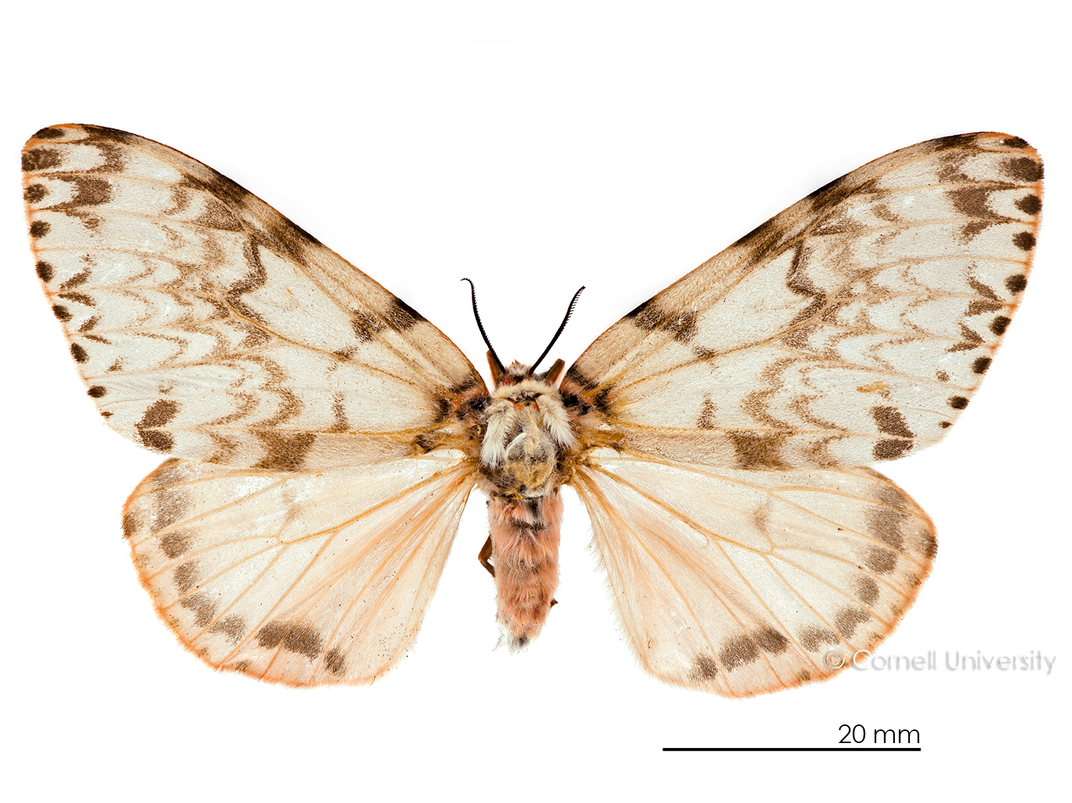
Lymantria mathura*, Rosy moth
Synonyms: Portheria mathura, Ocneria mathura, Lymantria aurora, Lymantria fusca,
Lymantria mathura aurora
Common names: pink gypsy moth, Russian gypsy moth, rosy gypsy moth
Notes:
The rosy moth, Lymantria mathura, is a relative of the introduced European gypsy moth, Lymantria dispar dispar. It is not known to be present in the United States.

Slide 3
Lymantria mathura*, Rosy moth
Background
Impact
Pathways
Identification and insect biology
Hosts
Signs and symptoms
Scouting
What to do if you suspect you find it
Resources
Notes:
This presentation will provide you with an understanding of its potential impact should it be introduced to the US, and the likely pathways for its introduction and spread.
Additionally you will learn how to recognize signs and symptoms caused by this and similar pests and what to do if you suspect an infestation.

Slide 4
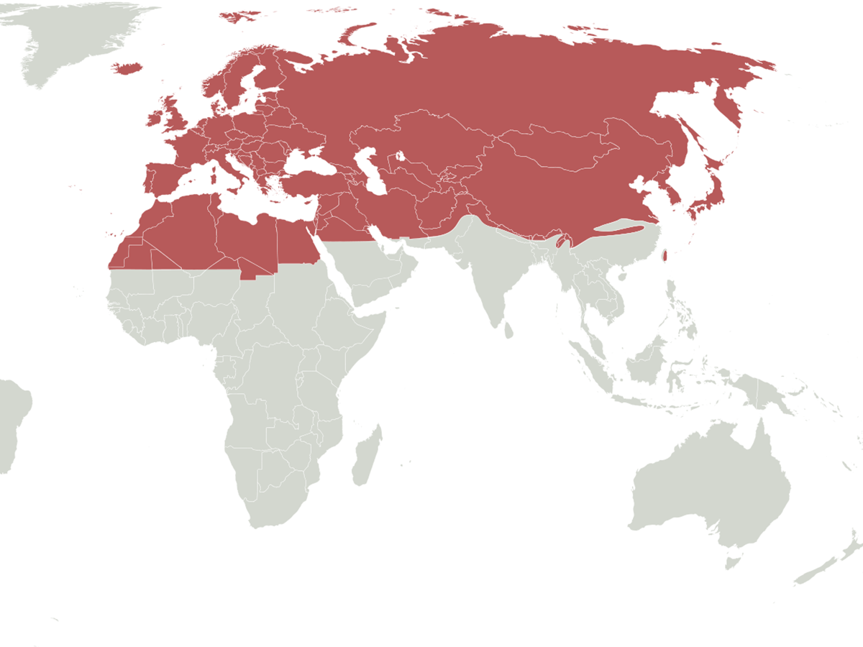
Background
Palearctic ecozone
Significant defoliator in the Palearctic region
Outbreaks often result in complete defoliation and have enhanced outbreaks of the related Lymantria dispar.
Map source: wikipedia
Notes:
The rosy moth is an important defoliator in the Palearctic ecozone; primarily in Eastern Asia from India to the Russian Far East.
The life cycle/biology of this species overlaps with the European gypsy moth which may make damage more severe.

Slide 5
Background
Map source: Invasive Species Compendium, www.cabi.org
Notes:
Record outbreaks have occurred in India, Russia and Korea with some outbreaks extending over adjacent forest divisions. The species has also been known to defoliate apple orchards in Japan.
For these reasons and because other exotic insects and diseases have been introduced via trade unknowingly, we are concerned about the introduction of new potential invasive species.

Slide 6
Potential impact
Ecological suitability—medium
Host availability—high
Establishment potential—medium
Environmental—high
Economic—high
Entry potential—low
Notes:
The United States Department of Agriculture, Animal and Plant Health Inspection Service (USDA-APHIS) conducts risk assessments on imminent insect and disease threats. A score is given that rates how big of a risk a pest or disease poses to our country.
Based on the USDA assessment of these and other categories, the overall, potential impact of Lymantria mathura within an infested area scored high.

Slide 7
Potential ecological impact
Score—medium
US biomes (habitat types) likely to support rosy moth are highlighted in yellow
38% of the continental US has a suitable habitat and climate
Source: CAPS PRA L. mathura, mini risk assessment
Notes:
To determine the potential distribution of a quarantine pest in the US, USDA considers the worldwide geographic distribution of the species and identifies the biomes where the species is established.
This map was constructed during the initial risk assessment and illustrates where the rosy moth is most likely to encounter a suitable climate for establishment in the US. Approximately 38% of the continental US would have a suitable climate to support its establishment.
This method produces relatively coarse data so it is possible that the populations could potentially establish outside of the yellow areas as well.

Slide 8
Host availability
Notes:
Lymantria mathura is a polyphagous pest of taxonomically diverse trees that has been reported to feed on more than 45 genera in 24 families many of which are common across the United States. While the susceptibility of US species has yet to be determined, rosy moth still scores high in this category because it is not host specific.

Slide 9
Establishment potential
Score—medium
Uncertainty—high
Large areas in US could support establishment
US hosts not known
Many genera of Asian hosts occur over large areas in the US
Notes:
A fair amount of uncertainty is associated in regard to establishment potential and it received a rating of medium. To come up with the rating for this category USDA considers the suitable climate/biomes as well as host availability. If genera that are known hosts in Asia prove to be hosts in the US, many of them occur over broad geographic areas and in relatively high densities.
To complicate the rating for this category, all stages potentially can be brought into the US on or in infested plant material and there is always the potential that they could be missed during inspection.

Slide 10
Environmental impact
Score—high
Reduce biodiversity
Disrupt ecosystem function
Degrade critical habitat
Endanger threatened plants
Increase use of chemical or biological control
Photo: © William M. Ciesla, Forest Health Management International, Bugwood.org
Notes:
An introduced species can have devastating effects on the environment should it become established. When assessing environmental impact such things as—affects on biodiversity and disruption of overall ecosystem function are considered.
Rosy moth has a broad host range so it has the potential to directly affect forest composition. Any time you have weakened and stressed trees, those trees are more vulnerable to attack by secondary pests and environmental stresses which could ultimately lead to tree death and increased risk of fires.

Slide 11
Economic impact
Score—high
Reduction in yield or total crop loss (fruit crops)
Timber losses
Domestic and/or international quarantines may impact trade
Photo: © Manfred Mielke, USDA Forest Service, Bugwood.org
Notes:
Lymantria mathura larvae are gregarious defoliators and they feed on leaves, flowers and young shoots. Defoliation can be complete—leaving only the midrib and hardened veins behind. Damage of this nature often results in decline in overall growth and development, and can cause a reduction in yield or total crop loss (fruit crops).
According to the European and Mediterranean Plant Protection Organization (EPPO) Lymantria mathura is one of the most important defoliators within its current range. It is capable of defoliating large areas and its feeding has resulted in complete forest and orchard defoliation.
In 2000 Canada declared it an actionable quarantine pest and in 2005 the EPPO placed it on their A2 quarantine pest list. A2 pests have limited distribution in the EPPO region and member countries are required to regulate them to limit their distribution. If the rosy moth was to be introduced to the US, both domestic and international quarantines would have a negative impact on US trade.

Slide 12
Entry potential
Score—low / uncertain
No records of L. mathura interceptions between 1985–2004
Interceptions identified “Lymantriinae; species of” more frequent
Mostly associated with
permit cargo, international airline baggage, general cargo
cut flowers
Photo: © Karen Snover-Clift, Cornell University
Notes:
Entry potential considers how easily this pest could enter the US. There have not been any known records of Lymantria mathura interceptions at US ports of entry however specimens identified to subfamily have been intercepted. Most of the interceptions have been on non-host material.
Rosy moth has the ability to move through trade the same way that European gypsy moth can and females have been documented to be attracted to ships and port lighting.
________________________________________________________________________________
(NOTE: Lymantriinae is the new subfamily name for Lymantriidae.)

Slide 13
Introduction pathways
Has not been intercepted at US ports of entry, however moths identified to subfamily have
Has been found to be associated to ship and port lighting in Russian Far East
Similar pathways as Lymantria dispar
Photo: © Manfred Mielke, USDA Forest Service, Bugwood.org
Notes:
The most significant pathway for rosy moth and other Asian defoliator species is on cargo from the Far East. It has been observed that female Asian gypsy moths are attracted to ship and port lighting and lay egg masses on non-host material including ships and shipping containers. Asian gypsy moths egg masses can tolerate extremes in both temperature and moisture; making them extremely hardy.
All stages of the life cycle can be transported on plants moving in trade, particularly plants for planting and cut branches. Egg masses are small and well hidden, which make them difficult to detect. Eggs may be associated with wood with bark of different trees or in crevasses on other articles.
If introduced, Lymantria mathura can spread naturally by flight of adult moths—both male and female.

Slide 14
Insect biology & ecology
Flight activity at dusk (same as Lymantria dispar) mating occurs at night
Female moths fly
Eggs are laid between early September to mid October
Females become inactive after egg laying, congregating in groups near egg masses
Males are short lived and are rarely seen
Notes:
Flight activity (for mating) coincides with European gypsy moth—both fly at dusk however L. mathura mates at night and L. dispar mates during the day.
Unlike L. dispar—the European gypsy moth, female Asian gypsy moths commonly fly.
Eggs are laid between early September and mid October and females cover egg masses with hairs from their abdomens. Female moths become inactive after egg laying and congregate in groups near egg masses. Males are short lived and are rarely seen.

Slide 15
Insect biology & ecology
Eggs overwinter under bark scales and on other media/articles and are typically well hidden
Eggs hatch in spring when leaves become available for feeding
First instar larvae disperse via silk thread—(ballooning)
Late instar larvae feed at night and return to the trunk during the day
Larvae are known to rest in an inverted “J” position on trunks
Pupae are present from late July to late October
Notes:
The number of generations per year is determined by location. Within its native range rosy moth has 1–2 generations per year. In the US, European gypsy moth has one. It is believed that rosy moth would have one generation per year in the US.
Eggs with almost completely developed larvae overwinter under bark scales. Eggs hatch in spring when leaves become available for feeding.
Like European gypsy moths, newly hatched rosy moth caterpillars disperse through ballooning—that is via silken threads. Late instar larvae feed at night and return to the trunk during the day. Larvae are known to rest in an inverted “J” position on trunks with both anterior and posterior ends pointing downward.
Pupation often occurs in groups and pupae can often be found in protected areas of branches, in leaf litter and elsewhere. Pupae are present from late July to late October.

Slide 16
Field recognition
Confirmation must be made by a national identifier

Slide 17
Recognizing Lymantria spp.
European gypsy moths
Lymantria spp. can be identified by the diagnostic arc/dot feature shown below.
Notes:
There are several species of Lymantria from Asia that are not known to be established in the US. You may be familiar with and recognize the European gypsy moth, shown here, which has naturalized in much of the Northeast.
Lymantria spp. can be identified by the diagnostic arc/dot feature as marked by the arrows in these images.

Slide 18
Lymantria mathura — identification
Photo: © Shipher Wu, flickr
Notes:
Lymantria mathura should be easy to recognize in the adult form as no other native moths resemble them. However, individuals that are suspected to represent an introduction of L. mathura should be identified by a taxonomist with expertise in the subfamily Lymantriinae.

Slide 19
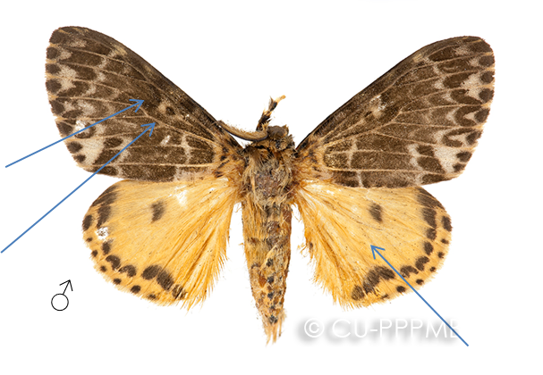
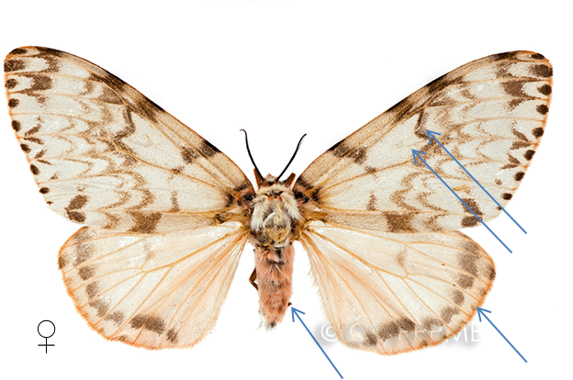
Identification—adults
For complete accuracy, the following morphological descriptions are quoted from Moore (1865) and Roonwal (1979b).
“Lymantria mathura (Lepidoptera: Lymantriidae) is a moderate sized moth...
There is marked sexual dimorphism in size and colour…In females the forewings are white with dark markings and the hindwings pink...”(Roonwal 1979b).
Notes:
Adult moths are hairy, heavy bodied and of moderate size.
Males have densely marked forewings and yellow hindwings and abdomen.
Females look very different from the males—this trait is known as sexual dimorphism. Note the arc dot, while present, is rather obscured by the markings especially in the male.

Slide 20
Identification—males
Forewing length
male FW length: 21–24 mm
Key features
males yellow hindwings and abdomen
Notes:
Males have beige forewings with dark-brown markings. The hindwings and abdomen are yellow. Their forewings bear an obscured arc/dot feature diagnostic for Lymantria spp.
_________________________________________________________________________________________________________
For complete accuracy, the following morphological descriptions of L. mathura are quoted from Moore (1865) and Roonwal (1979b).
“Upperside-forewing greyish white, markings brown, with pale-brown interspaces; with two or three black and yellow spots at the base; two transverse subbasal irregular lines, between which is a broad band; a round spot within the cell and a blackish curved streak at its end; three transverse discal lunulated bands, the first broad, the others narrow; a marginal row of spots: hind wing dull yellow, with a blackish discal spot, narrow submarginal maculated band, and a marginal row of small spots. Underside dull yellow, suffused with pale brown between the veins, with darker-brown discal and marginal spots. Thorax white, with yellow and black spots. Abdomen yellow, tuft white, with dorsal, lateral, and a row beneath of black spots. Head at the sides, palpi in front, and legs yellow; palpi above and at the sides, and spots on the legs, black. Antennae brown. Expanse 2¼ inches” (Moore 1865).

Slide 21
Identification—females
Forewing length
female ~38 mm
Key features
females whitish with pink abdomen and hindwings
no native look-alike species
Notes:
Females are whitish with rosy-pink hue on all wings and abdomen, with rosy coloration most pronounced on the hindwings. The forewings are not as heavily marked so the arc/dot is more apparent.

Slide 22
Identification—eggs
Covered with a thick felt-like covering of long, white, silken hairs
Similar to European gypsy moth egg masses only white as opposed to buff
Each egg mass contains about 50–1,200 eggs laid 2 to 4 eggs deep
Photo: © F.M Wang, flickr
Notes:
Eggs are covered over with a white, nearly one-millimeter thick felt-like covering composed of long, white, silken hairs. European gypsy moth egg masses look similar but are more buff or tan in color.
Each egg mass contains about 50–1,200 or more eggs which are laid 2 to 4 layers deep directly on the bark.
Egg masses look distinctly different after egg hatch—felt covering or hairs which remain have become a dirty cream color, possibly with some buff color. Hatched caterpillars leave holes of varying diameters in eggs upon emergence.

Slide 23
Larvae
For complete accuracy, the following morphological descriptions are quoted from Moore (1865) and Roonwal (1979b).
“Three main colour forms are found in mature caterpillars, the following proportions being noticed in 1,613 caterpillars examined: grey-white 66%, intermediate 11%, and blackish brown 23%...
In the masses of caterpillars on tree trunks the various colour types are mixed on individual trees; this fact has a protective value by making detection by enemies difficult” (Roonwal 1979b).
Photo: © Harum Koh, flickr
Notes:
____________________________________________________________________________________________________
For complete accuracy, the following morphological descriptions are quoted from Moore (1865) and Roonwal (1979b).
“Three main colour forms are found in mature caterpillars, the following proportions being noticed in 1,613 caterpillars examined: grey-white 66%, intermediate 11%, and blackish brown 23%...
In the masses of caterpillars on tree trunks the various colour types are mixed on individual trees; this fact has a protective value by making detection by enemies difficult” (Roonwal 1979b).

Slide 24
Identification—larvae
Form I (Grey-white)
Ground color dirty white tinged with grey
Two transverse yellow-brown bands
Hair pencils present both anteriorly and posteriorly
Ventral: brownish pink; legs and prolegs brown
Photo: © Patrick Randall, flickr
Notes:
For complete accuracy, the following morphological descriptions are quoted from Moore (1865) and Roonwal (1979b).
Form I (Grey-white): ground colour dirty white tinged with grey
Dorsal: head white with numerous black or brown spots; frons with a longitudinal median black streak; rest of body grey-white, with numerous fine dots forming paired patches. A transverse yellow-brown streak present between pro- and mesothorax, and another in middle of metathorax: abdominal warts blackish; paired lateral papules on abdomen white, with tufts of long white and brown hairs. Long pencil-like plumes of black hairs at both the anterior and posterior ends.
Ventral: brownish pink; legs and prolegs brown, the latter with a black patch externally.

Slide 25
Identification—larvae
Form II (Intermediate)
Ground color pale brown
Median white patch on abdominal terga 4 and 5
Ventral same as Form I
Form III (Blackish brown)
Dorsal: ground-color dark brown to almost black
Numerous black spots visible in brown larvae but merged with ground-color in darker ones
Several small white dots present on abdominal terga 4 to the last, and large white patches on terga 4-6.
Ventral: ashy, suffused with a little pink in the median parts; rest as in Form I.
Photo form III: © David Mohn, Critters Page, Bugwood.org
Notes:
__________________________________________________________________________________________
For complete accuracy, the following morphological descriptions are quoted from Moore (1865) and Roonwal (1979b).
Form II (Intermediate): ground color pale brown; median white patch on abdominal terga 4 and 5; ventral same as Form I
Form III (Blackish brown): ground-color dark brown to almost black
Dorsal: numerous black spots visible in brown larvae but merged with ground-color in darker ones. Several small white dots present on abdominal terga 4 to the last, and large white patches on terga 4-6.
Ventral: ashy, suffused with a little pink in the median parts; rest as in Form I.

Slide 26
Similar species—Dryocampa rubicunda rosy maple moth, green striped mapleworm
Photos: clockwise from left © M. Hodges, flickr; A. Reago & C. McClarren, Wikimedia Commons and R. Crook, flickr
Notes:
While the rosy maple moth does not look at all like the rosy moth — Lymantria mathura, the common names are similar enough that it deserves a mention here.
The rosy maple moth, Dryocampa rubicunda, is a native moth that can be found in eastern half of North America. While it is not considered a pest, it can cause defoliation in outbreak situations. The rosy maple moth typically feeds on maples.
Color is quite variable. Adult moths are distinctly pink and yellow-cream colored; lighter form is common in Missouri and is mostly white or white with pink markings.

Slide 27
Rosy moth hosts
Polyphagous pest of taxonomically diverse deciduous (and conifer) trees including: oak, especially in the white oak group; apple, beech, cherry / plum
Reportedly feeds on more than 45 genera in 24 families—some threatened and endangered hosts
In outbreak years, tends to lay eggs on many non-host species
Notes:
In an outbreak in the Western sub-Himalayan range, L. mathura eggs were laid on 185 different host species, and of these, 22 tree species were later defoliated by feeding larvae, and 6 species were heavily defoliated.

Slide 28
Hosts, cont…
Fagaceae (including oaks, beeches)
Salicaceae (willows)
Rosaceae (apples, pears, cherries)
Betulaceae (birches)
Juglandaceae (hickories, walnuts)
Oleaceae (ashes)
Notes:
The larvae of L. mathura feed on various families of broad-leaf trees including Fagaceae (oaks and beeches), Salicaceae (willows), Rosaceae (apples, pears and cherries), Betulaceae (birches), Juglandaceae (hickories and walnuts), Oleaceae (ashes) and a number of tropical families of trees.

Slide 29
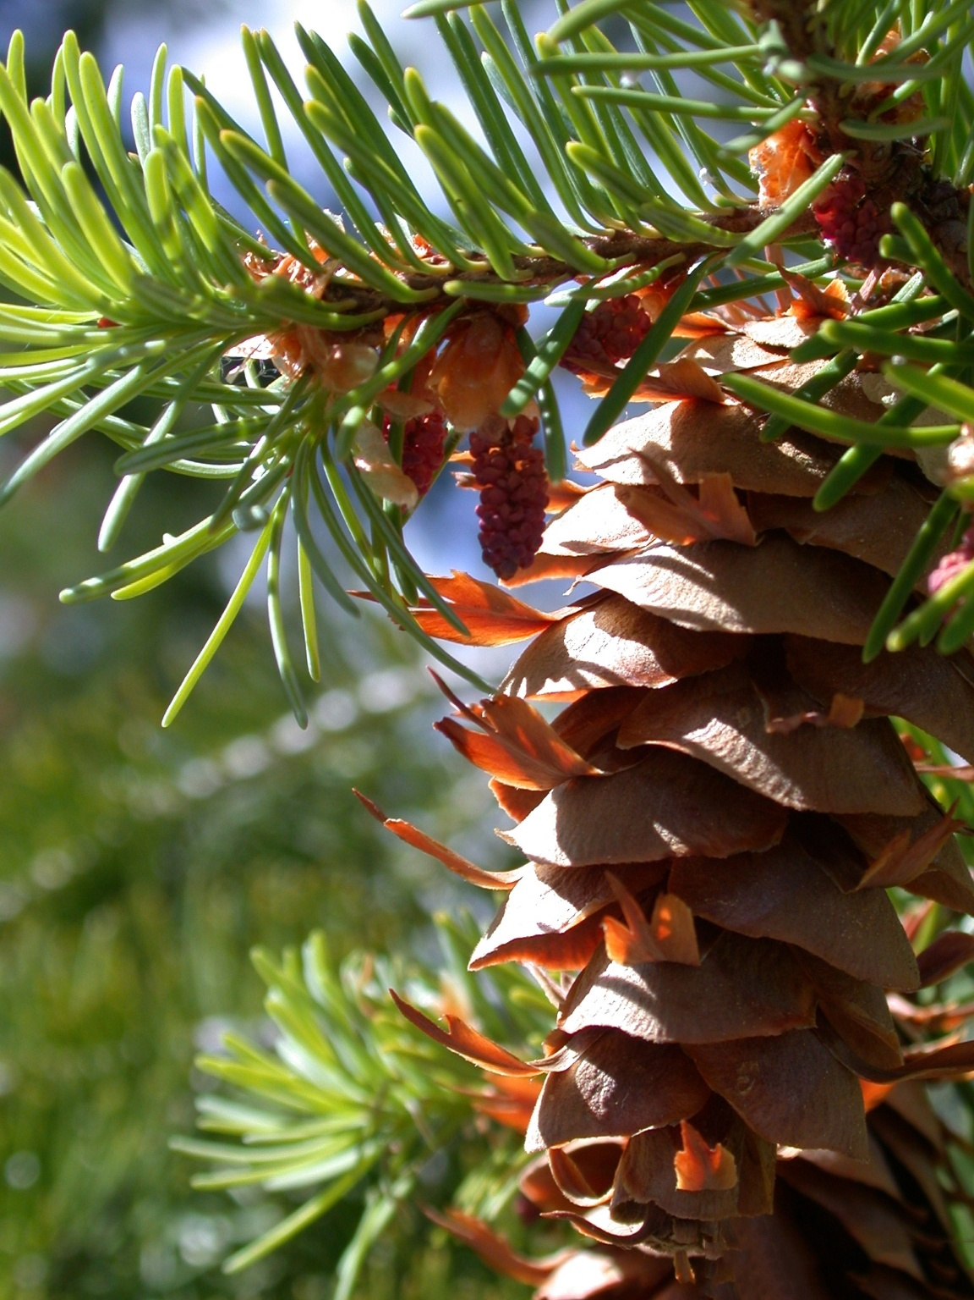
Other hosts
Pseudotsuga menziesii
Abies (true fir)
Pinus (pine)
Larix (larch)
Photo: © Mary Ellen (Mel) Harte, Bugwood.org
Notes:
Rosy moth larvae can also survive on conifer foliage. Larvae reared on plants in the family Pinaceae, including the genera Abies (true fir), Pinus (pine) and Larix (larch), displayed less than 13% survivorship and those reared on Douglas fir (Pseudotsuga menziesii) averaged 33% survivorship.

Slide 30
Signs and symptoms
Photo: rosy moth defoliation © Galina Yurchenco, Far Eastern Forestry Research Institute, Khabarovsk, Russia
Notes:
Lymantria mathura causes damage to trees primarily by eating the leaves. In outbreak years entire trees can be defoliated.

Slide 31
Signs and symptoms
Defoliation of flowers and leaves of host plants
Early instars make shot-hole damage
Heavy infestations can result in complete defoliation or defoliation down to midrib and veins
Photos of rosy moth defoliation © Galina Yurchenco, Far Eastern Forestry Research Institute, Khabarovsk, Russia
© Hans Henrik Bruun, University of Copenhagen
Notes:
Symptoms include defoliation of leaves and flowers of host plants. Young caterpillar feeding resembles shot-holes. As caterpillars get larger damage becomes more apparent with heavy infestations resulting in complete defoliation leaving nothing but the midrib and hardened veins.

Slide 32
Signs and symptoms
Photo: © Harum Koh, flickr
Presence of insect life stages—eggs, caterpillars and adult moths
During outbreaks, eggs are laid indiscriminately and could be found in a variety of places
© Hans Henrik Bruun, University of Copenhagen

Slide 33
Scouting
Photo: © USDA-APHIS-PPQ, Bugwood.org
Notes:
These recommendations can be used as a general guide when scouting for Lymantria mathura or other Asian Lymantria spp. Since these species are not known to be in the US, timing may vary slightly.

Slide 34
Scouting
Check host plants coming from overseas for signs
Look for egg masses in winter
Monitor preferred hosts for defoliation damage
Look for feeding larvae during summer and fall
Notes:
Check host plants coming in from overseas for various life stages. Some life stages can be concealed or cryptic when moving in trade and could go unnoticed.
Check for eggs on trees and other outdoor objects in winter. Look for feeding larvae during summer and fall.

Slide 35
Scouting
No native moths look like rosy moth adults
Field identification can be done with the use of diagnostic aids
Confirmation needs to be made by an expert
Photos: © Shipher Wu, flickr
Notes:
Adult rosy moths—both male and female—do not look like any of our native moths. If you see a moth which looks like the rosy moth take action.

Slide 36
Scouting
Trap and lures are available if you are interested to monitor for rosy moth.
For more information check out scouting resources in the Sentinel Plant Network toolbox.
Photo: © William M. Ciesla, Forest Health Management International, Bugwood.org
Notes:
If your garden is located in a high-risk area consider deploying traps baited with pheromone lures to assist with your monitoring efforts. Two wing trap kits are available for rosy moth—paper or plastic. The lure is effective for three months.
For more information visit the Sentinel Plant Network toolbox, under scouting resources.

Slide 37
What you should do…
Lymantria mathura is a high-consequence insect pest of quarantine significance. It is not currently known to be established in the US.
Symptoms of L. mathura are similar to those caused by other defoliators.
If you see symptoms described here in this presentation, look more closely for signs of the insect.

Slide 38
Contact your state NPDN lab…
If you think you have found signs of Lymantria mathura, that is, ANY life stage of the pest, contact the NPDN diagnostician in your state immediately!
Take a series of quality photographs and send them to the diagnostician.
Ask about sending in a physical sample.

Slide 39
Send in a proper sample…
Remember the following tips when sending samples that are considered to be significant or high-consequence:
Use a shatterproof container or sturdy lockable bag
Double bag or place container in a second lockable bag
Place these in another sturdy container
Include ALL of the proper sample submission forms required by your NPDN lab
Record the host plant and thoroughly complete all forms!
Notes:
Remember when sending samples that are considered to be significant or high-consequence these tips…
Capture multiple, whole specimens if possible.
Kill insects by placing them in the freezer for 24 hours.
Loosely wrap insects in tissue and place in a small crush proof container or sturdy lockable bag
Place container or bag in another lockable bag
Place these in a sturdy shipping container
Include ALL of the proper sample submission forms required by your NPDN lab and be sure to include as much information as possible! For example, host plant data is very important for identification and research purposes.
Review NPDN’s sample submission module and contact your state diagnostician if you have sample collecting or packaging questions.

Slide 40
References
Covell, C.V., Jr. 2005. A field guide to moths of eastern North America. Virginia Museum of Natural History, Martinsville, VA.
Davis, E.E., S. French, and R.C. Venette. 2005. Mini-Risk Assessment: Pink gypsy moth, Lymantria mathura Moore [Lepidoptera: Lymantriidae]. http://www.aphis.usda.gov/plant_health/plant_pest_info/pest_detection/downloads/pra/lmathurapra.pdf.
EPPO. 2005. Data sheets on quarantine pests: Lymantria mathura. European and Mediterranean Plant Protection Organization. http://www.eppo.org/QUARANTINE/insects/Lymantria_mathura/DSLYMAMA.pdf. .
Molet, T. 2012. CPHST Pest Datasheet for Lymantria mathura. USDA-APHIS-PPQ-CPHST.
Pogue, M. G. and P. W. Schaefer. 2007. A review of selected species of Lymantria Hübner [1819] including three new species (Lepidoptera: Noctuidae: Lymantriinae) from subtropical and temperate regions of Asia, some potentially invasive to North America. Forest Health Technology Enterprise Team Technology Transfer. FHTET-2006-07.

Slide 41
Questions
On this module or the NPDN contact Rachel McCarthy at rachel.mccarthy@cornell.edu
On how to collect or submit a sample contact your state NPDN diagnostician at www.npdn.org

Slide 42
Presentation Credits
Authored by
Rachel L. McCarthy, NPDN-SPN Manager, Department of Plant Pathology and Plant-Microbe Biology, Cornell University
Reviewed by
Melody Keena, PhD, Research Entomologist, Forest Service Northern Research Station, Hamden, CT
Ryan St. Laurent ‘16, Department of Entomology, Cornell University

Slide 43
Publication details
This publication can be used for non-profit, educational use only purposes. Photographers retain copyright to photographs or other images contained in this publication as cited. Authors and the website should be properly cited. Images or photographs should also be properly cited and credited to the original source.
Published—September 2015

Slide 44
The Sentinel Plant Network
The Sentinel Plant Network (SPN) is a collaboration between the American Public Gardens Association (APGA) and the National Plant Diagnostic Network (NPDN) and is funded through the USDA’s Animal and Plant Health Inspection Service (APHIS).
Notes:
The partnership, dubbed the Sentinel Plant Network is a cooperative project between the American Public Gardens Association (APGA) and the National Plant Diagnostic Network (NPDN) with funds for cementing the union coming from USDA-APHIS.
We believe that the never ending battle to slow or stop exotic pest and pathogen introductions can best be waged by the combined efforts of two organizations with similar goals.
The Sentinel Plant Network is expected to enhance diagnostic capabilities via improved communication between public gardens and expert diagnostic facilities with access to advanced technologies.

Slide 45
The Sentinel Plant Network’s Mission
The Sentinel Plant Network contributes to plant conservation by engaging public garden professionals, volunteers and visitors in the detection and diagnosis of high-consequence pests and pathogens.
For more information on the Sentinel Plant Network visit www.sentinelplantnetwork.org

