Slide 1
Siberian Silk Moth
Sentinel Plant Network Pest/Pathogen Series
Notes:
This presentation will introduce you to the Siberian silk moth, a pest not known to be in the United States that poses a serious risk to US urban and forest ecosystems should it be introduced. USDA has been and continues to survey for this pest but we ask that members of the Sentinel Plant Network keep their eyes out for it as well.
The text provided in the notes section is not meant to be read verbatim to the audience. It is meant to provide the speaker with the necessary background information to support what is presented on each slide.

Slide 2
Dendrolimus sibiricus*, Siberian silk moth
According to the EPPO this is the currently accepted name
Synonyms-Dendrolimus superans sibiricus and Dendrolimus laricis
Notes:
The Siberian silk moth, Dendrolimus sibiricus, is the most harmful defoliator of coniferous forests in North Asia. It does not yet occur in North America.

Slide 3
Dendrolimus sibiricus
Background
Impact
Pathways
Identification and insect biology
Photo: © Natalia Kirichenko, Bugwood.org
Notes:
This presentation will provide you with a better understanding of Dendrolimus sibiricus, the Siberian silk moth, its potential impact should it be introduced to the US, and the likely pathways for its introduction and spread.

Slide 4
Dendrolimus sibiricus, cont…
Hosts
Signs and symptoms
Scouting
What to do if you suspect you find it
Resources
Photo: © Natalia Kirichenko, Bugwood.org
Notes:
Additionally you will learn how to recognize signs and symptoms caused by this and similar pests and what to do if you suspect an infestation.

Slide 5
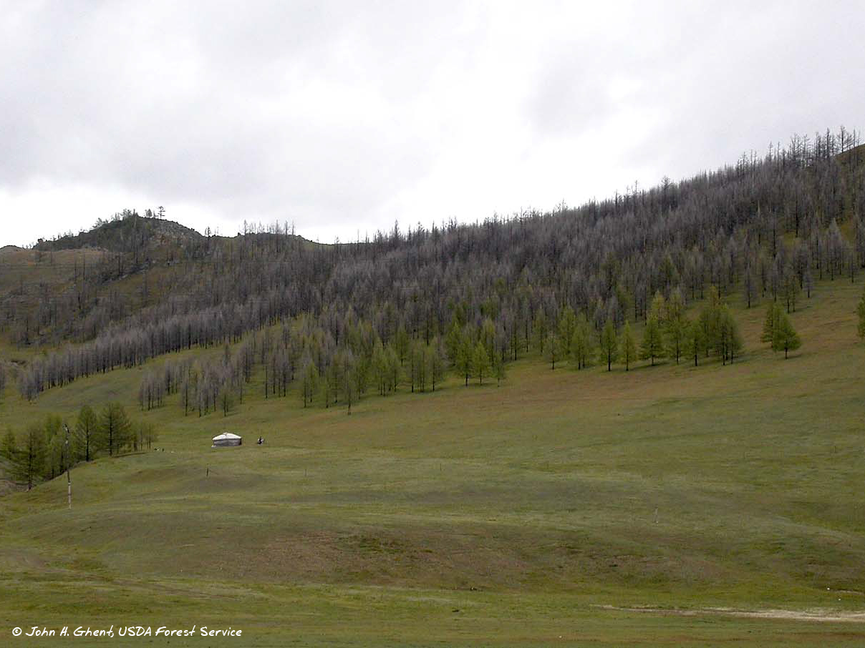
Background
Believed to have originated in Siberia
Outbreaks have occurred in China, Russia (particularly Asian and Siberian Russia and the Russian Far East), Japan, Mongolia, Poland and North and South Korea
Notes:
The Siberian silk moth, Dendrolimus sibiricus, is able to attack and kill healthy plants and has been known to kill trees and forests across very wide areas. This photo shows damage done to a forested area in Mongolia.

Slide 6
Background
Notes:
It poses a serious threat to Europe and North America.

Slide 7
Potential impact
Economic suitability – high
Ecological impact – high
Environmental – high
Establishment potential – high
Host availability – moderate to low
Entry potential – low
Photo: © John H. Ghent, USDA Forest Service, Bugwood.org
Notes:
The USDA-APHIS conducts risk assessments on imminent insect and disease threats. A score is given that rates how big of a risk a pest or disease poses to our country.
Based on the USDA assessment of these and other categories, the overall, potential impact of Dendrolimus sibiricus within an infested area scored high.
During the 1999-2002 outbreak in the Republic of Yakutia (Russia) approximately 20 million acres of larch stands were damaged.

Slide 8
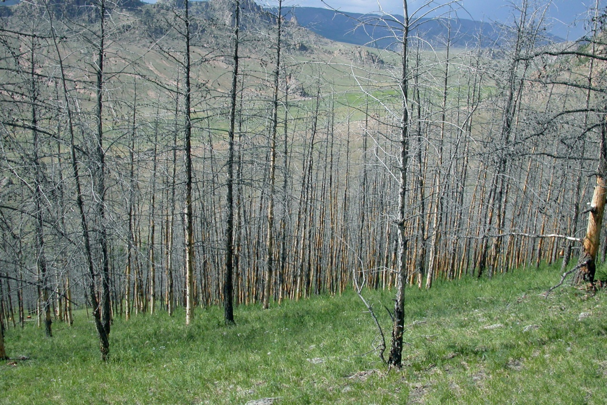
Potential economic impact
High
Timber losses
Domestic and/or international quarantines may impact trade
Photo: © John H. Ghent, USDA Forest Service, Bugwood.org
Notes:
Dendrolimus sibiricus is an economically important defoliator within its native range. During outbreak years D. sibiricus larvae kill thousands to millions of hectares of forests.
Overall timber losses as well as decreased value of host product/timber resources for damaged trees.
Quarantines affect trade. Both domestic and international quarantines would have a negative impact on US trade.

Slide 9
Potential ecological suitability
High
US biomes (habitat types) likely to support Siberian silk moth are highlighted in red
79% of the continental US has a suitable habitat/climate
Source: CAPS PRA D. superans, mini risk assessment
Notes:
To determine the potential distribution of a quarantine pest in the US, USDA considered the worldwide geographic distribution of the species and identified the biomes where the species is established.
This map was constructed during the initial risk assessment and illustrates where the pest is most likely to encounter a suitable climate for establishment.
However, it is now thought that establishment in the southern half of the country would be less likely because the species requires a need for cold temperatures.

Slide 10
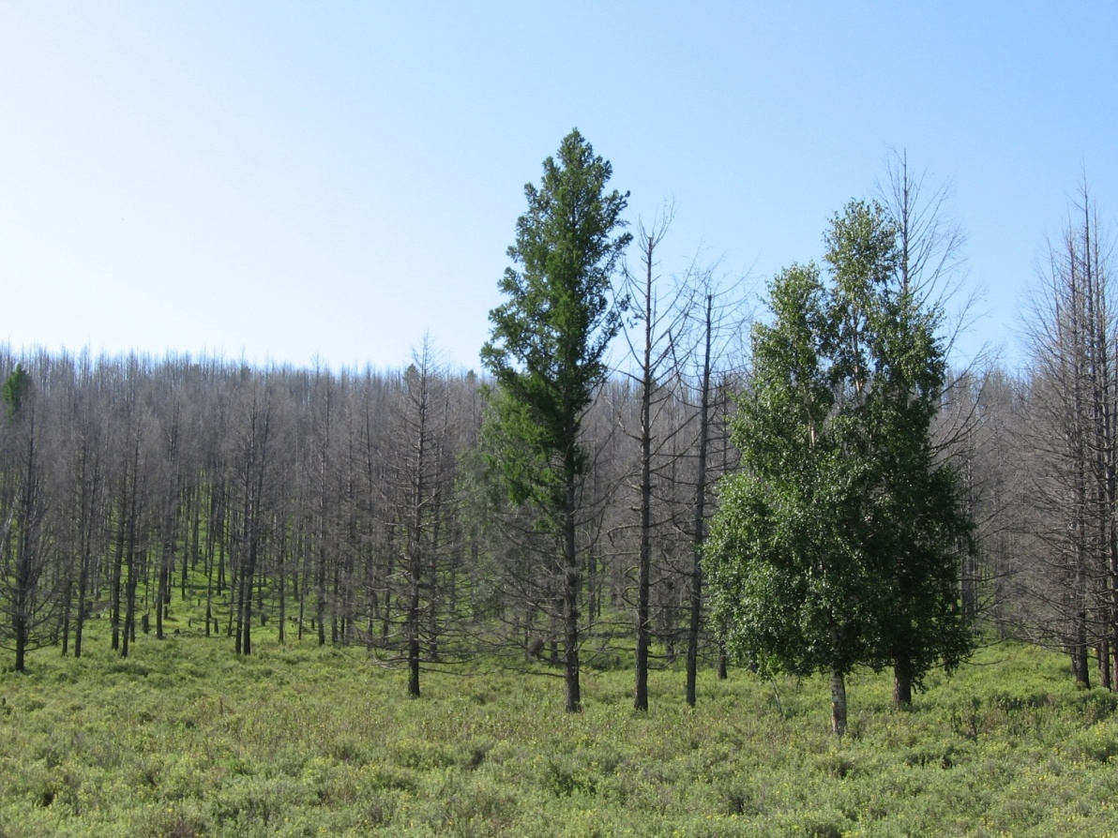
Potential environmental impact
High
Reduce biodiversity
Disrupt ecosystem function
Degrade critical habitat
Endanger threatened plants
Increase use of chemical or biological control
Photo: © Vladimir Petko, V.N. Sukachev Institute of Forest SB RAS, Bugwood.org
Notes:
Forest damage, defoliation and mortality have significant impacts on both the environment and ecosystem health. When assessing environmental impact such things as – affects on biodiversity and disruption of overall ecosystem function are considered.
Any time you have weakened and stressed trees, those trees are more vulnerable to attack by secondary pests and environmental stresses which could ultimately lead to forest death and increased risk of fires. Newly established, invasive species can have devastating effects on the environment.

Slide 11
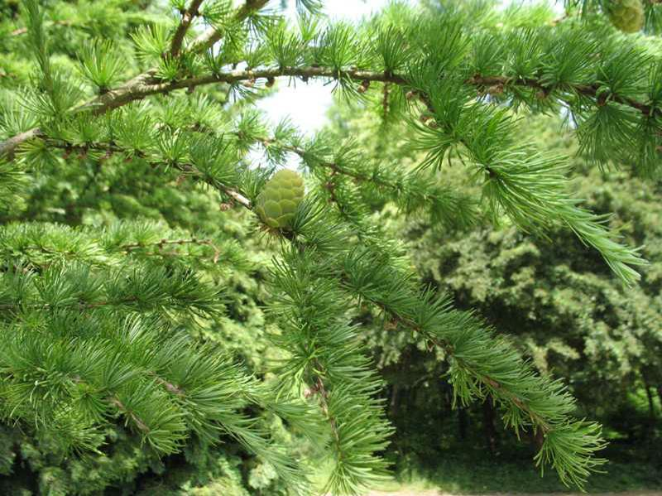
Host availability
Low…however
Preferred host species are more likely to occur in ornamental settings
Several species which are endangered or threatened would be at risk
Photo: © www.missouribotanicalgarden.org/PlantFinder
Larix gmelinii var. principis-rupprechtii
Notes:
Although D. sibiricus is moderately host specific, they still feed on over 20 coniferous species. Many of the species it feeds on within its native distribution are not available in the US so it would have to feed upon species that it has not yet encountered.
The susceptibility of US species has yet to be determined.

Slide 12
Entry potential
Low - uncertain
Dendrolimus sp. are in the family Lasiocampidae – which are ALL actionable
Transported within infested plant material
Cryptic stages
Vlad Proklov, public.fotki.com/kotbegemot/entomology/lasiocampidae.html
Notes:
A great deal of uncertainty is associated with entry potential. This is due in part because identification to species is not required AND because the number of interceptions are drastically lower as compared to other pests entering the US.
The genius Dendrolimus belongs to the family Lasiocampidae. All members of this family are considered “actionable”. Which means that an inspector only needs to identify it to family, before a regulatory decision is made to intercept that cargo or shipment. Specimens identified as “Lasiocampidae” have been more frequent than those confirmed as D. sibiricus.
Because all stages of the moth are crypic, it may easily be overlooked during inspections and thereby brought in within infested plant material.

Slide 13
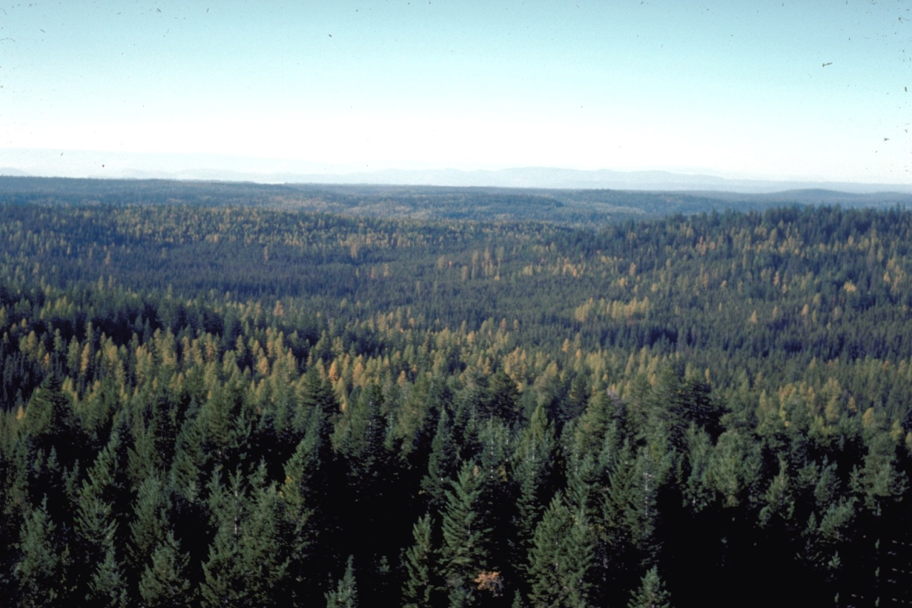
Establishment potential
High
Cryptic stages could be missed during routine inspections
Much of the US has a suitable climate and host plants for establishment
Photo: © Dave Powell, USDA Forest Service, Bugwood.org
Notes:
A fair amount of uncertainty is associated in regard to the potential establishment of Dendrolimus sibiricus but it still receives a rating of high in this category. All stages can be brought into the US on or in infested plant material and there is always the potential that they could be missed during inspection. Additionally, as we saw earlier, USDA estimates that much of the continental US has a suitable climate and host plants to support establishment of D. sibiricus.
So even though introduction potential is considered low, establishment potential rates high should D. sibiricus make its way into the US.

Slide 14
Introduction pathways
Natural dispersal
Adult moths are strong fliers
D. sibiricus is extending its range westward by approximately 7.5-31 miles per year.
Notes:
In places where Dendrolimus sibiricus is native or has become established, it is spreading by approximately 7-31 miles per year.

Slide 15
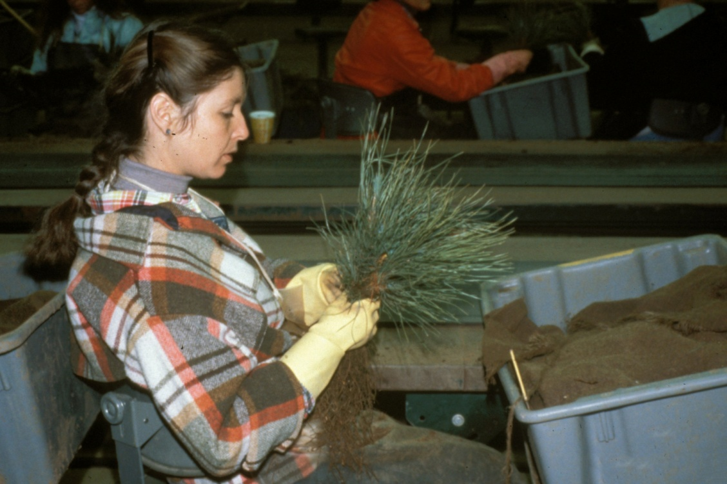
Introduction pathways
All stages can be transported on plants moving in trade particularly--
plants for planting, including seedlings and plants with soil intact
cut branches
Christmas trees
Photo: © Thomas D. ‘Tom’ Landis, USDA Forest Service, Bugwood.org
Notes:
Siberian silk moth can be introduced into new locations unknowingly by sharing infested plant resources. All stages can be transported on plants moving in trade, particularly plants for planting, within soil, on cut branches, even on artificial and live Christmas trees.

Slide 16
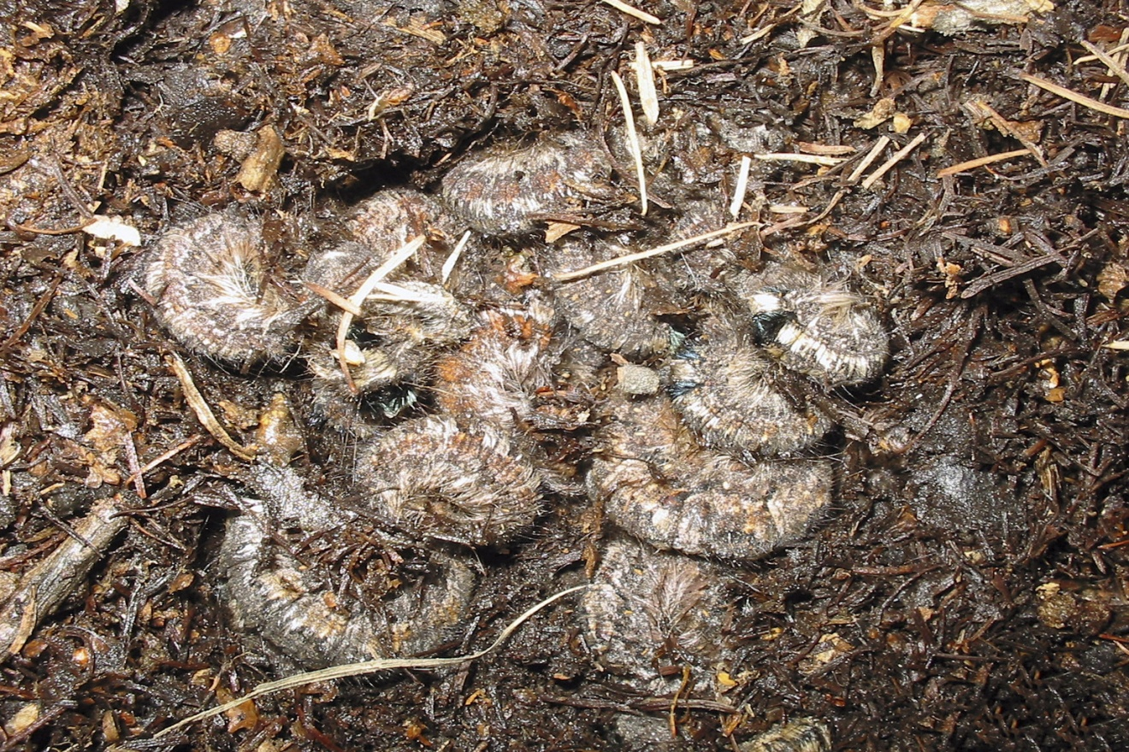
Introduction pathways
During outbreak years eggs and larvae can be associated with wood with intact bark and isolated bark
Photo: © John H. Ghent, USDA Forest Service, Bugwood.org
Notes:
Developing larvae overwinter in the soil, so again there is the potential for introduction via container or balled plants or seedlings.

Slide 17
Insect biology
Life cycle is complex and is affected by population density and climate
Typically requires two-three years to complete its life cycle (can be as little as one year and up to four years-EPPO 2005)
Adults from two generations can emerge simultaneously causing sharp population increases during an outbreak
Notes:
Under natural conditions the Siberian silk moth requires two-three years to complete its life cycle. However, in southern parts of its range it can complete its life cycle in one year.
The biology described here is based on typical life cycle in the middle latitudes within its native range.

Slide 18
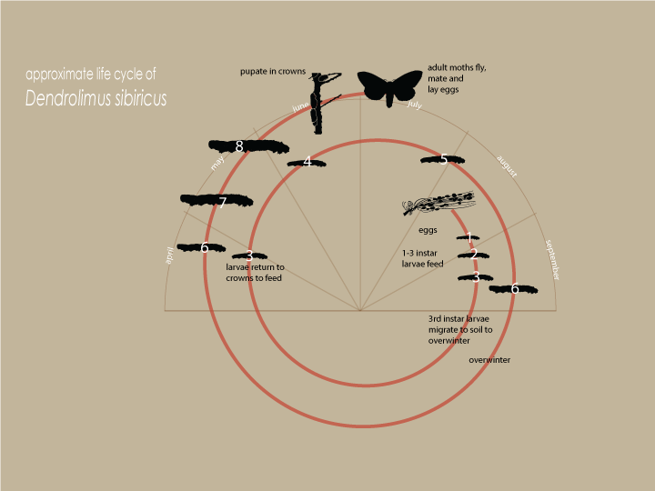
An establishment of D. sibiricus in the US could be a single year life cycle.
Notes:
Flight of adult moths occurs in mid-July. Immediately after mating, females lay eggs on the needles of host trees. Females lay an average of 200-300 eggs, with some laying as many as 800 eggs. Typically eggs are laid in the lower part of the crowns but in outbreak years eggs are laid throughout the tree and on nearby ground. The egg stage is typically present in the field for about 13-15 days.
First instar larvae feed on the edges of needles. With each instar the damage to the needles increases. In September, third instar larvae migrate to the soil to overwinter.
The following spring (end of April), larvae return to the crowns and feed on remaining needles and the bark of young shoots and cones. In autumn, the larvae migrate to the soil and overwinter for a second time.
In May and June of the next year, the larvae feed intensively eating about 95% of the food they require for development. This last instar is the most damaging. In total, larvae molt 5 to 7 times and have, correspondingly, 6 to 8 instars. In June, larvae construct cocoons. Pupation takes about one month.
An establishment of D. sibicus in the US could be a single year life cycle.

Slide 19
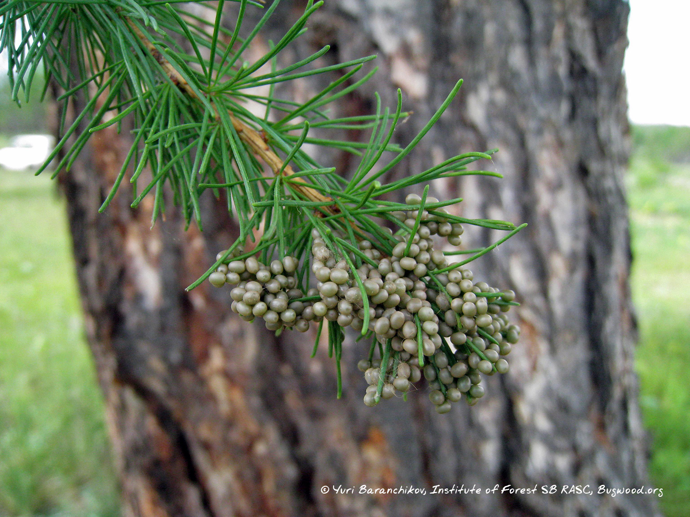
Eggs
Notes:
Siberian silk moth eggs are quite distinct and could easily be observed in the field.

Slide 20
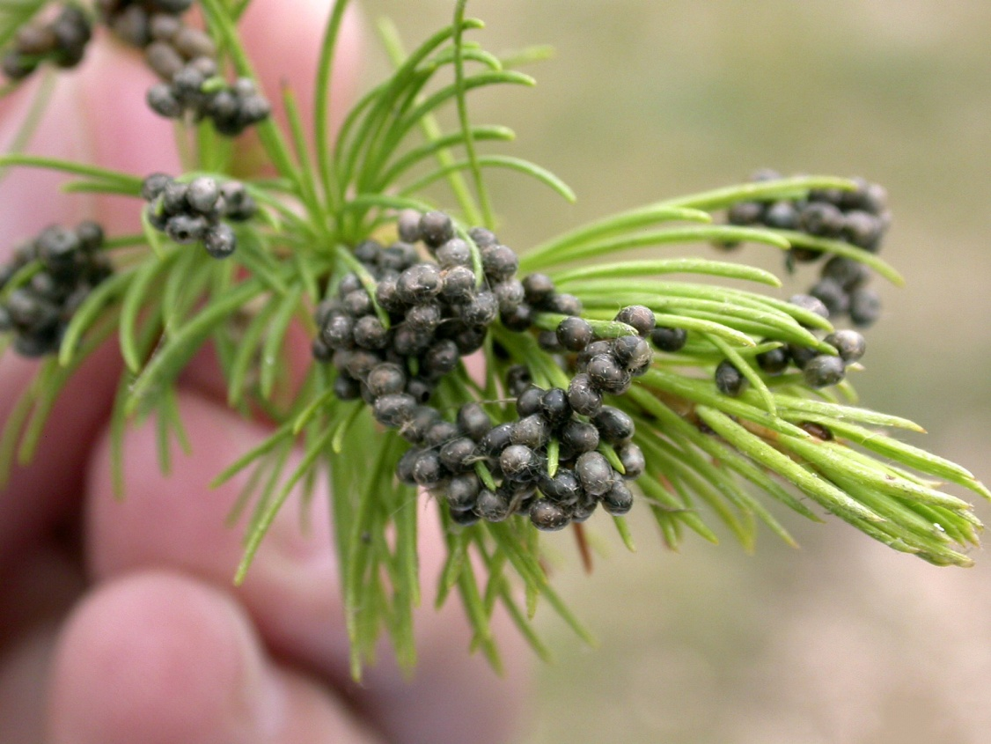
Identification—eggs
For diagnostic accuracy, the following descriptions are quoted from EPPO, 2005
About 2.2 x 1.9 mm [approx. 1⁄16 in]
Elongate
Light-green when laid, turning creamy-white, then becoming darker and spotted
Photo: © John H. Ghent, USDA Forest Service, Bugwood.org
Notes:
Eggs are elongate and light green when laid becoming darker and spotted as they age. Douglas fir tussock moth eggs may look somewhat like Siberian silk moth eggs.

Slide 21
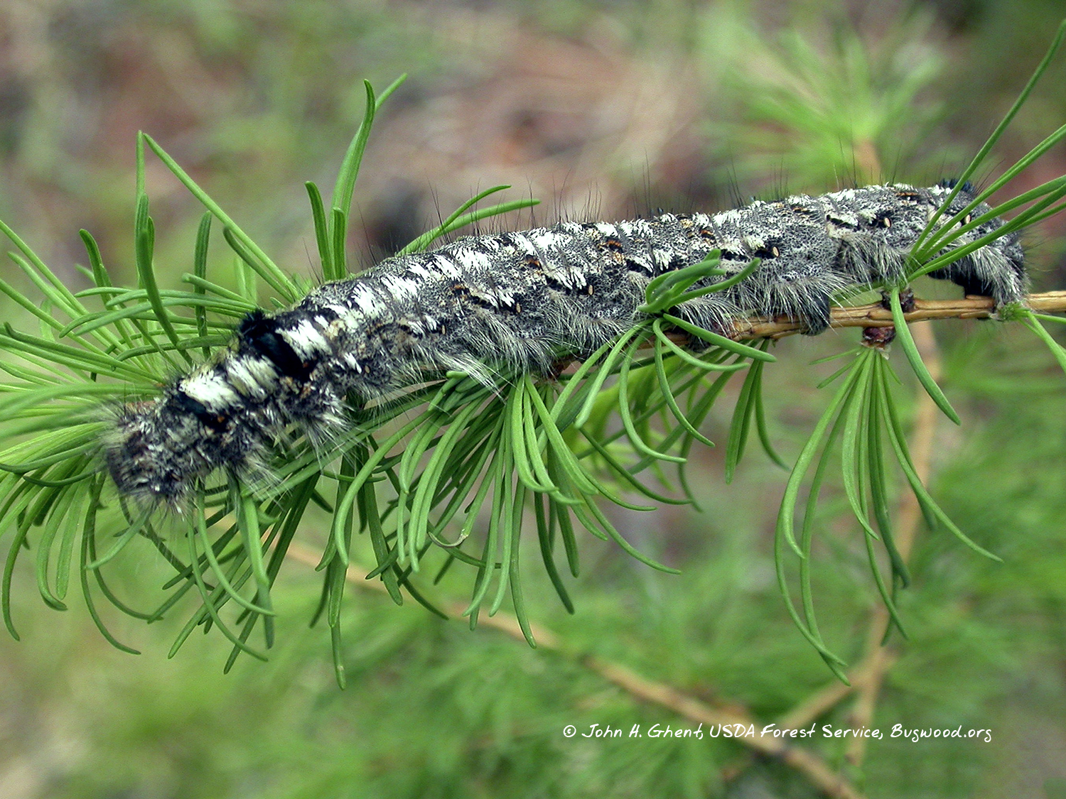
Larvae
Notes:
Any large, hairy voracious caterpillar on a conifer should be examined as a potential Dendrolimus invader.

Slide 22
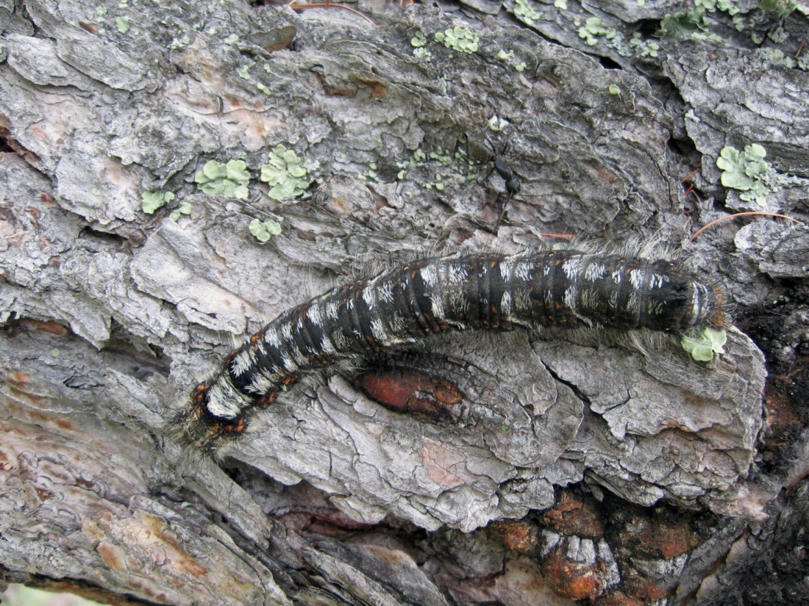
Identification—larvae
For diagnostic accuracy, the following descriptions are quoted from EPPO, 2005
The mature larvae are 55–70 mm [approx. 2 ³⁄₁₆ to 2 ³⁄₄ in] long and the 2nd and 3rd segments are marked with blue-black stripes.
Reddish setae are found on the sides of larvae, usually as red jagged bands or spots.
Larvae can be up to 110 mm [approx. 4 ³⁄₁₆ in] long.
Photo: © Yuri Baranchikov, Institute of Forest SB RASC, Bugwood.org
Notes:
The mature larvae average 2 ³⁄₁₆ to 2 ³⁄₄ inches long and the 2nd and 3rd segments are marked with blue-black stripes. Reddish setae are found on the sides of larvae, usually as red jagged bands or spots. There are records of larvae reaching over 4 inches in length.

Slide 23
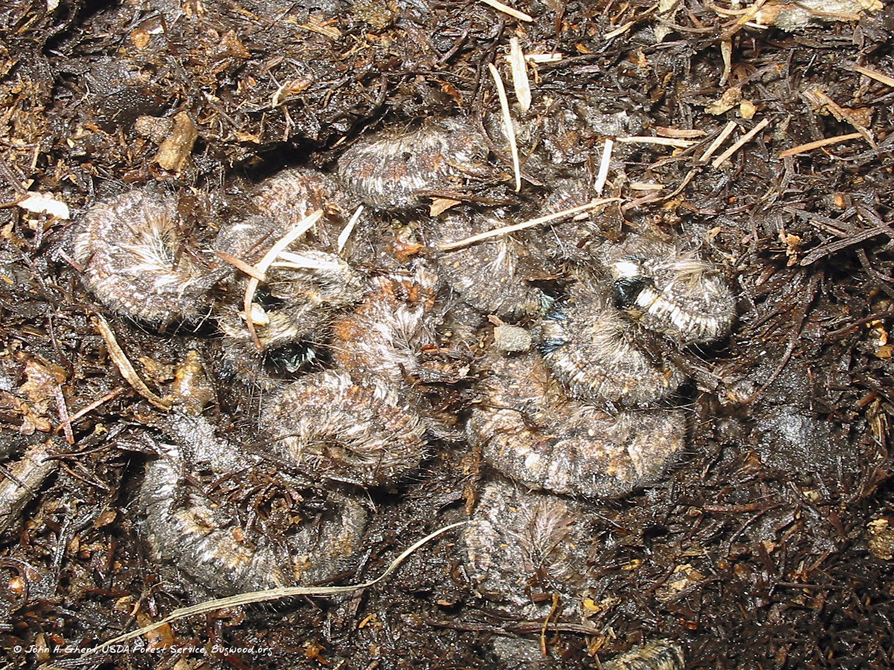
Overwintering larvae
Notes:
This image shows overwintering larvae in the leaf litter or duff layer.

Slide 24
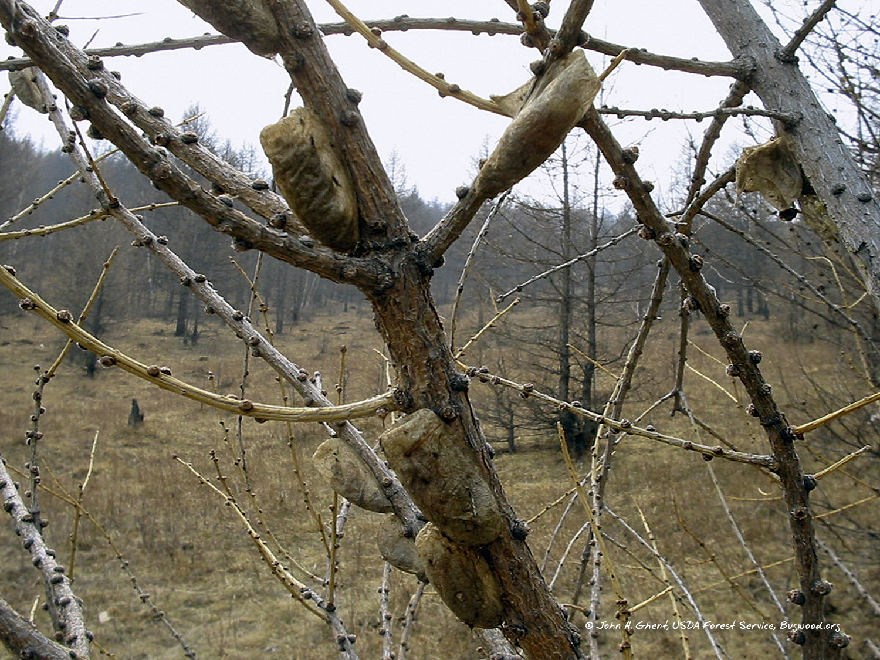
Pupae

Slide 25
Identification—pupae
For diagnostic accuracy, the following descriptions are quoted from EPPO, 2005
The pupa…is brown, 33–39 mm [approx. 1 ⁵⁄₁₆ to 1 ¹⁄₂ in] long in females, 28–34 mm [approx. 1 ¹⁄₈ to 1 ⁵⁄₁₆ in] in males.
Pupation occurs in cocoons spun with silk, needles and small branches. Cocoon is gray or brownish, 70 x 12 to 15 mm, compact, rough, with inclusion of hairs.
Photo: © Yuri Baranchikov, Institute of Forest SB RASC, Bugwood.org
Notes:
Pupation occurs in cocoons spun with silk, needles and small branches. The color varies, typically gray or brownish. They are compact and rough.

Slide 26
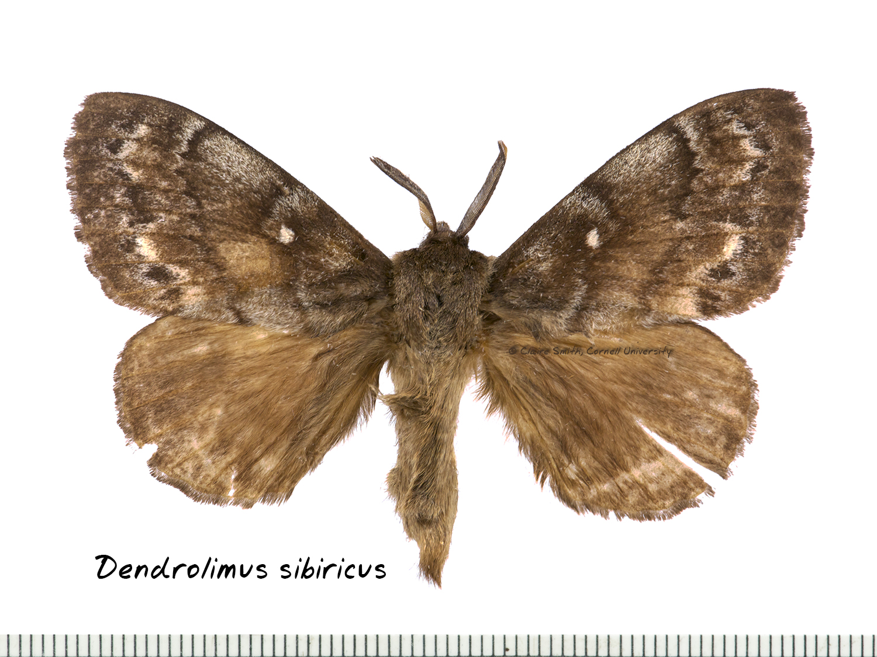
Adults

Slide 27
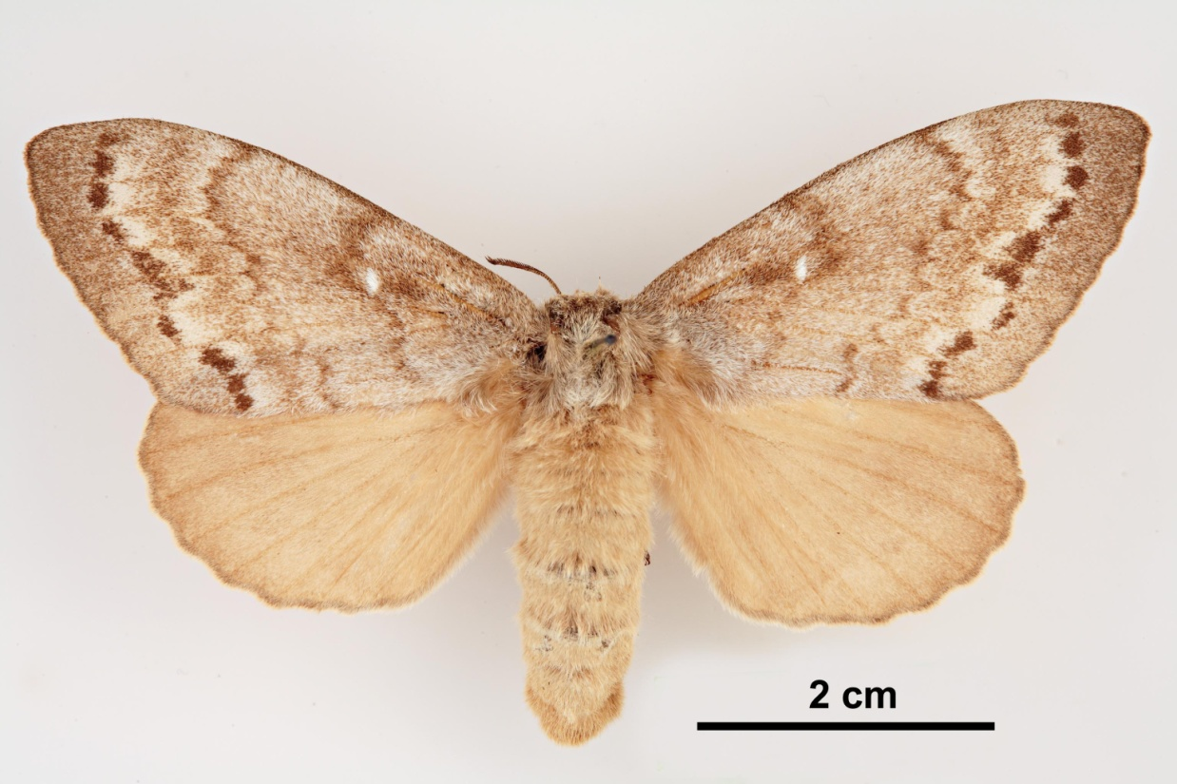
Identification—adults
For diagnostic accuracy, the following descriptions are quoted from EPPO, 2005
The female adult has a wingspan of 60–80 mm [approx. 2 ⅜ to 3 ⅛ in]. The male adults have a wingspan of 40–60 mm [approx. 1 ⁹⁄₁₆ to 3 ⅛ in].
The female body length averages 39 mm [approx. 1 ½ in], and the male body length averages 31 mm [approx. 1 ¼ in].
Photo: © Pest and Diseases Image Library, Bugwood.org
Notes:
Males and females are similar but females are larger, with broader wings.

Slide 28
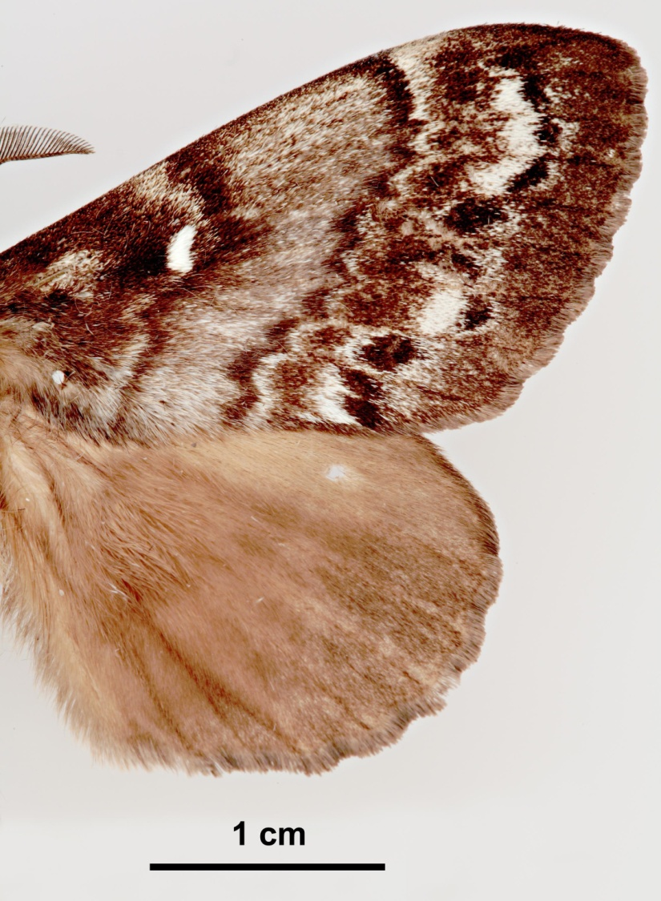
Identification—adults
For diagnostic accuracy, the following descriptions are quoted from EPPO, 2005
The color of the moths varies from light yellowish-brown or light gray to dark brown or almost black.
Front wings are marked by two characteristic dark stripes.
A white spot is located at the center of front wing.
Photo: © Pest and Diseases Image Library, Bugwood.org
Notes:
Key features of Dendrolimus sibiricus include three dark, notched stripes on the wings, which are rather indistinct due to various amounts of gray and brown scales. A white spot is usually present near the center of the forewings.

Slide 29
Hosts
Exclusively feeds on conifers in the Pinaceae family.
Hosts are genus specific
Preferred hosts within native range decrease in order:
Larix spp.
Abies spp.
Pinus spp. (five needle pines)
Picea spp.
Pinus spp. (two needle species)
Photo: © Steven Katovich, USDA Forest Service , Bugwood.org
Notes:
Within its native range and where it has established, D. sibiricus feeds exclusively on pines. Many of the known host species are not available in the US so it would have to feed upon species that it has not yet encountered.

Slide 30
Hosts, continued…
Host species in regard to European and North American conifers
Larix deciduas
Abies grandis
Pinus strobus
Psuedotsuga menziesii* (new host – not in native range of moth)
Cedrus* spp. and Tsuga* spp.
Photo: © Mary Ellen (Mel) Harte, Bugwood.org
Notes:
Douglas fir, Psuedotsuga mensiesii, is a recent new host for D. sibiricus. As previously mentioned, the susceptibility of US species is not known.

Slide 31
Signs and symptoms
A related species of pine moth, Dendrolimus spectabilis, showing similar symptoms of feeding on pine.
Photo: © G. Allard, www.fao.org/forestry/49410/en/mng/
Photo: © G. Allard, www.fao.org/forestry/49410/en/mng/
Notes:
Dendrolimus sibiricus causes damage to trees primarily by eating the leaves. In outbreak years entire trees can be defoliated. Symptoms of larval feeding include defoliation. Defoliation usually occurs over a large area and can be seen from satellites when populations are high.

Slide 32
Signs and symptoms
Photo: © Yuri Baranchikov, Institute of Forest SB RASC, Bugwood.org
Notes:
First instar larvae feed on the edges of needles. Later instars eat the entire needle. In addition, older larvae may eat portions of the plant buds, young cones and the bark of twigs.

Slide 33
Signs and symptoms
In areas where the moth’s life cycle takes two to three years, developing larvae will hibernate in the duff layer at the base of host trees.
During outbreak conditions, larvae can be found in mass.
Photo: © John H. Ghent, USDA Forest Service, Bugwood.org
Notes:
In areas where the moth takes two-three years to develop, larvae migrate to the duff layer at the base of host trees.
During outbreak conditions, larvae can be found in mass.

Slide 34
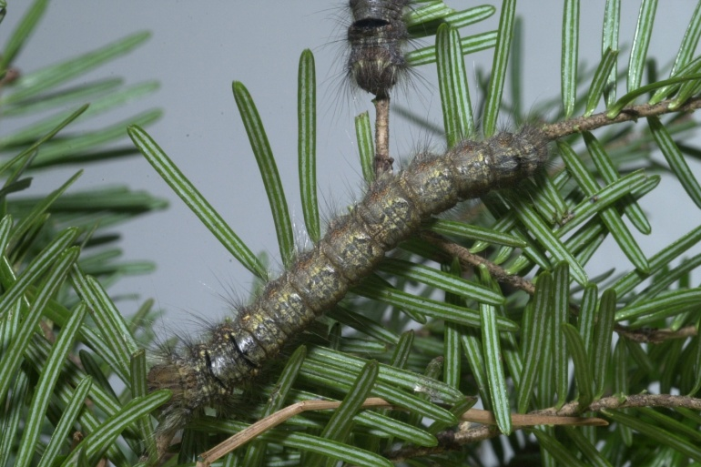
Scouting
August look for eggs
August-Sept. look for larvae
Overwinter as larvae in soil
Check host plants coming in from overseas for signs
Photos: 1,3 © John H. Ghent, USDA Forest Service, Bugwood.org. 2 © David R. Lance, USDA APHIS PPQ, Bugwood.org
Notes:
These recommendations can be used as a general guide when scouting for Dendrolimus sibiricus or other Dendrolimus spp. Since these species are not known to be in the US, timing may vary slightly.
Check for eggs on conifer trees in August and feeding larvae during summer and fall.
Check host plants coming in from overseas for various life stages. Some life stages can be concealed or cryptic when moving in trade and could go unnoticed.

Slide 35
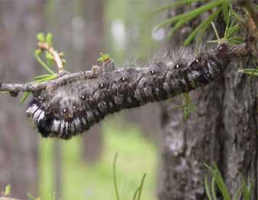
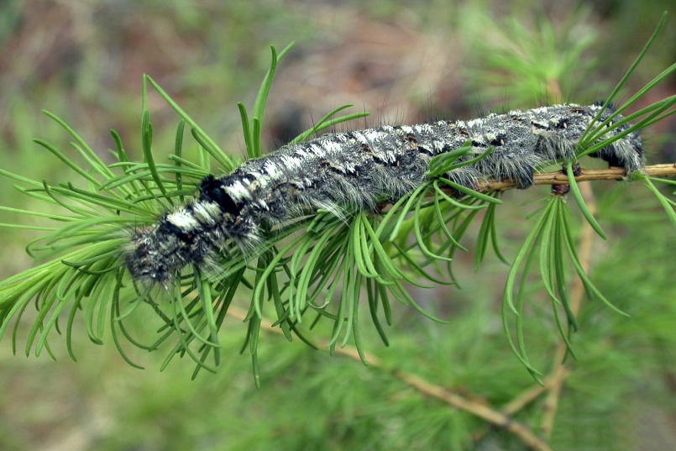
Scouting
Larvae come back to feed for a second summer and then again for a third summer before pupating.
Photos: 1,3 © John H. Ghent, USDA Forest Service, Bugwood.org. 2 © Yuri Baranchikov, Institute of Forest SB RASC, Bugwood.org
Notes:
Remember, any large hairy, voracious caterpillar feeding on a conifer should be looked at more closely.

Slide 36
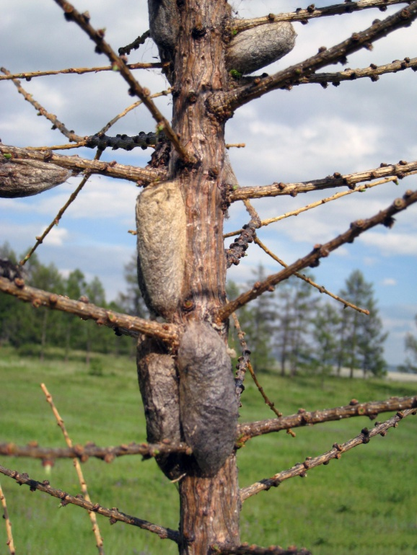
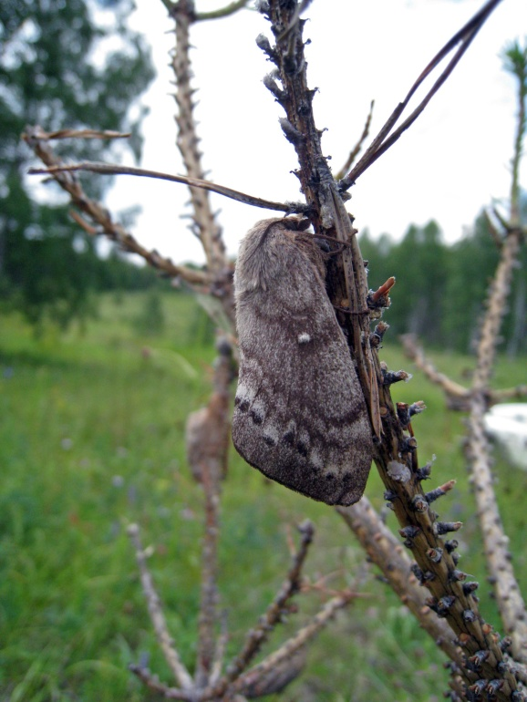
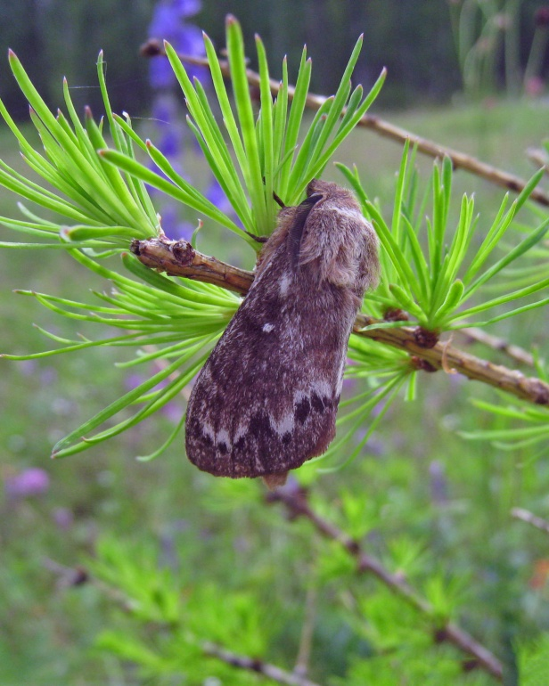
Scouting
About mid June-mid July look for pupae in crowns on stems and branches
Adult moths fly in mid July
Photos: © Yuri Baranchikov, Institute of Forest SB RASC, Bugwood.org
Notes:
About mid June-mid July look for pupae in crowns on stems and branches and adult moths would be most visible when they fly to mate and lay eggs in mid July.

Slide 37
What you should do…
Dendrolimus sibiricus is a high-consequence insect pest of quarantine significance. It is not currently known to be established in the US.
Symptoms of D. sibiricus are similar to those caused by other less serious pests.
If you see symptoms described here in this presentation, look more closely for signs of the insect.

Slide 38
Contact your state NPDN lab…
If you think you have found signs of Dendrolimus sibiricus, that is, ANY life stage of the pest, contact the NPDN diagnostician in your state immediately.
Take a series of quality photographs and send them to the diagnostician then ask about sending in a physical sample.

Slide 39
Send in a proper sample…
Remember the following tips when sending samples that are considered to be significant or high-consequence:
Use a shatterproof container or sturdy lockable bag
Double bag or place container in a second lockable bag
Place these in another sturdy container
Include ALL of the proper sample submission forms required by your NPDN lab
Notes:
Remember when sending samples that are considered to be significant or high-consequence these tips…
Capture multiple, whole specimens if possible.
Kill insects by placing them in the freezer for 24 hours.
Loosely wrap insects in tissue and place in a small crush proof container or sturdy lockable bag
Place container or bag in another lockable bag
Place these in a sturdy shipping container
Include ALL of the proper sample submission forms required by your NPDN lab
Review NPDN’s sample submission module and contact your state diagnostician if you have sample collecting or packaging questions.

Slide 40
References
http://wiki.bugwood.org/Dendrolimus_sibiricus
Davis, Erica E., French, Sarah & Venette, Robert C. 2005. Mini Risk Assessment Siberian Silk Moth, Dendrolimus superans Butler [Lepidoptera: Lasiocampidae]. September 29, 2005.
Molet, T. 2012. CPHST Pest Datasheet for Dendrolimus sibiricus. USDA-APHIS-PPQ-CPHST.
www.eppo.org/QUARANTINE/insects/Dendrolimus_sibiricus/DS_Dendrolimus_spp.pdf

Slide 41
Questions
On this module or the NPDN contact Rachel McCarthy at rachel.mccarthy@cornell.edu
On how to collect or submit a sample contact your state NPDN diagnostician at www.npdn.org

Slide 42
Presentation Credits
Authored by
Rachel L. McCarthy, NPDN-SPN Manager, Department of Plant Pathology and Plant-Microbe Biology, Cornell University
Reviewed by
John H. Ghent, USDA Forest Service Entomologist, Ashville, North Carolina

Slide 43
Publication details
This publication can be used for non-profit, educational use only purposes. Photographers retain copyright to photographs or other images contained in this publication as cited. Authors and the website should be properly cited. Images or photographs should also be properly cited and credited to the original source.
Published—December 2013

Slide 44
The Sentinel Plant Network
The Sentinel Plant Network (SPN) is a collaboration between the American Public Gardens Association (APGA) and the National Plant Diagnostic Network (NPDN) and is funded through the USDA’s Animal and Plant Health Inspection Service (APHIS).
Notes:
We believe that the never ending battle to slow or stop exotic pest and pathogen introductions can best be waged by the combined efforts of two organizations with similar goals.
The partnership, dubbed the Sentinel Plant Network is a cooperative project between the American Public Gardens Association (APGA) and the National Plant Diagnostic Network (NPDN) with funds for cementing the union coming from USDA-APHIS.
The Sentinel Plant Network is expected to enhance diagnostic capabilities via improved communication between public gardens and expert diagnostic facilities with access to advanced technologies.

Slide 45
The Sentinel Plant Network’s Mission
The Sentinel Plant Network contributes to plant conservation by engaging public garden professionals, volunteers and visitors in the detection and diagnosis of high-consequence pests and pathogens.
For more information on the Sentinel Plant Network visit www.sentinelplantnetwork.org

