Slide 1
Tremex wood wasp
Sentinel Plant Network Pest/Pathogen Series
Notes:
This presentation will introduce you to the Tremex wood wasp, Tremex fuscicornis, a pest not known to be in the United States that may pose a serious risk to US urban and forest ecosystems should it be introduced. USDA has been and continues to survey for this pest but we ask that members of the Sentinel Plant Network keep their eyes out for it as well. Monitoring for the Tremex wood wasp is difficult because damage symptoms develop slowly and look like those caused by other native borers, drought or stress.
The text provided in the notes section is not meant to be read verbatim to the audience. It is meant to provide the speaker with the necessary background information to support what is presented on each slide.

Slide 2
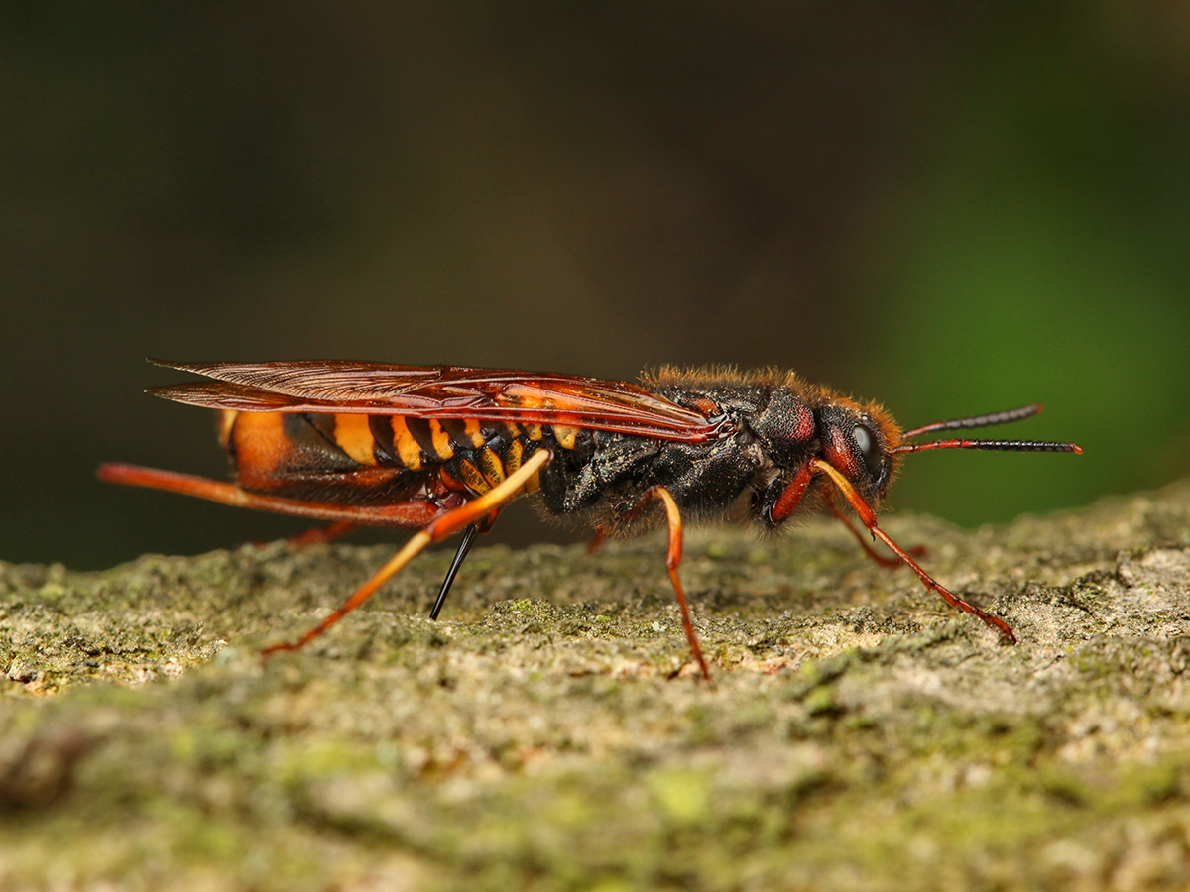
Tremex fuscicornis, Tremex wood wasp
Synonyms include: Sirex camelogigas, Sirex fuscicornis, Sirex struthiocamelus, Tremex juxicernis, Tremex simulacrum, Urocerus fuscicornis, Xylocemantium fuscicornis, Xyloterus fuscicornis.
Other common names: avila taladradora de la madera (Spanish), Tremex wasp
Photo: © Stanislav Krejcik, meloidae
Notes:
Tremex fuscicornis, the Tremex wood wasp, is an invasive insect that attacks many hardwood tree families that are common in the US.
In its home range, the Tremex wood wasp is not a serious pest; there it attacks weakened or recently killed trees. Outside of its native range, however, it has been known to attack healthy trees.

Slide 3
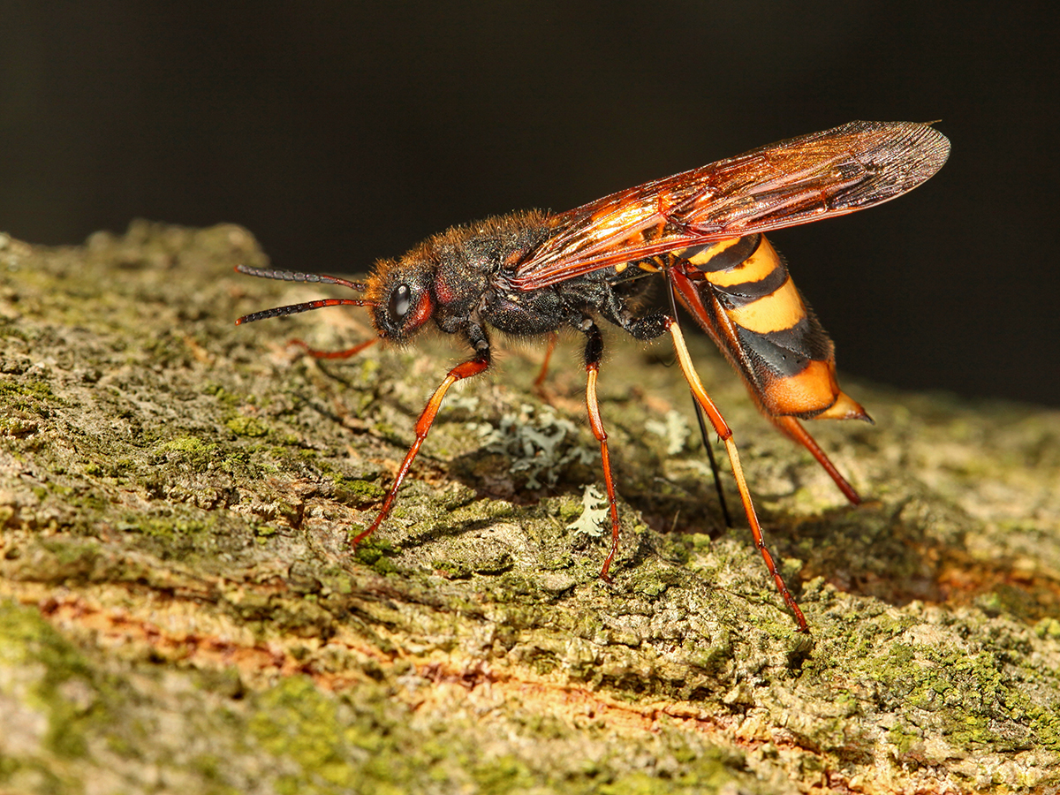
Tremex fuscicornis
Photo: © Stanislav Krejcik, meloidae
Background
Impact
Pathways
Insect biology and identification
Hosts
Signs and symptoms
Scouting
What to do if you suspect you find it
Submitting samples
Notes:
This presentation will provide you with a better understanding of Tremex fuscicornis, the Tremex wood wasp, its potential impact should it be introduced to the US, and the likely pathways for its introduction and spread.
Additionally you will learn how to recognize signs and symptoms caused by this and similar pests and what to do if you suspect an infestation.

Slide 4
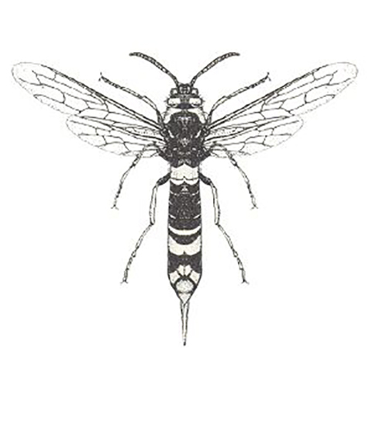
Background
Tremex fuscicornis is a non-stinging, wood boring wasp in the family Siricidae.
Siricid larvae feed on wood-decaying fungi that is introduced by the female when laying eggs.
Adult Tremex fuscicornis (CSIRO, 2004)
Notes:
The Tremex wood wasp is a non-stinging wasp in the family Siricidae. Like other siricid wasps, Tremex fuscicornis use a specialized fungus that decays wood making it easier for their larvae to digest.

Slide 5
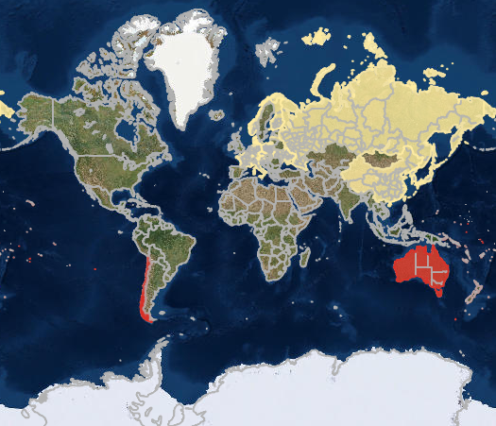
Geographic Distribution
Native to Asia and Europe
Introduced to Australia
Introduced to Chile, Argentina
Map courtesy of USDA FA EXFOR
Photo: © Louis-Michel Nageleisen, Département de la Santé des Forêts, Bugwood.org
Notes:
Tremex fuscicornis is native to Eurasia, including most of Europe and Asia. In its home range, T. fuscicornis attacks weakened and dying trees.
Unfortunately, T. fuscicornis has been introduced to Australia and Chile, where it has caused extensive damage. In these regions the wasp is killing healthy trees in addition to stressed ones. In Chile the resulting damage has removed windbreaks from the landscape, resulting in substantial crop damage. It has also killed otherwise healthly trees in parks and urban areas.

Slide 6
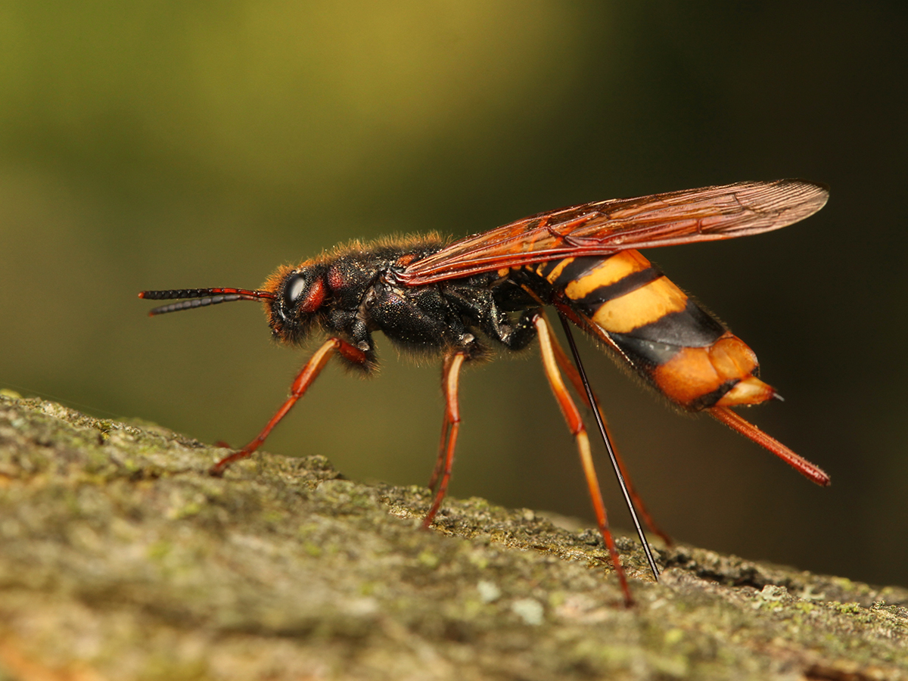
Potential impact
Overall: Very high
Uncertainty: High
Should T. fuscicornis be introduced it would have to compete with our native pigeon tremex.
Photo: © Stanislav Krejcik, meloidae
Notes:
Various plant protection agencies in the US (and abroad) conduct risk assessments on exotic insect and disease pests to predict the impact should they be introduced. Based on these assessments Tremex fuscicornis received an overall impact rating of high.
At the same time however, it received a high uncertainty rating. The reason for the uncertainty score is twofold. It is not known how tremex wood wasp would compete against native wood boring insects and similar siricid species here in the US—most notably the native pigeon tremex. Additionally, the fact that it is not a pest within its native range but is acting differently where it has been introduced make it hard to quantify potential impact.

Slide 7
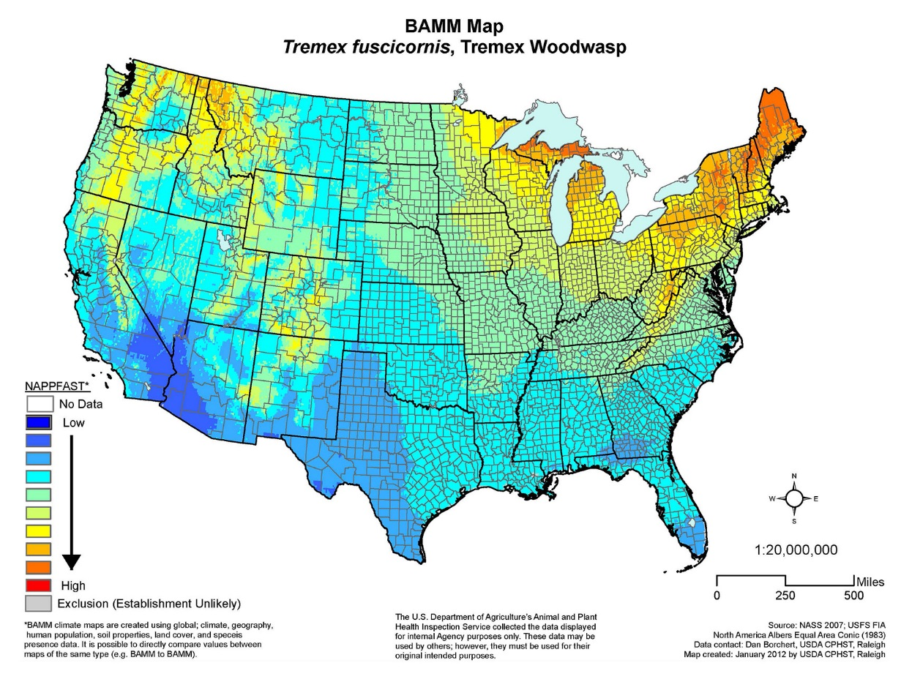
Potential
Ecological Suitability
High
Suitable climate zones 3–11
Many suitable host species
NAPPFAST BAMM Map source: CERIS Pest Tracker
Notes:
To determine the potential distribution of a quarantine pest in the US, USDA considers the worldwide geographic distribution of the species and identifies the biomes where the species is established.
Within its native range, Tremes fuscicornis could survive and establish in zones 3–11. This map was constructed during an initial risk assessment and illustrates where Tremex wood wasp is most likely to encounter a suitable climate and host range for establishment.

Slide 8
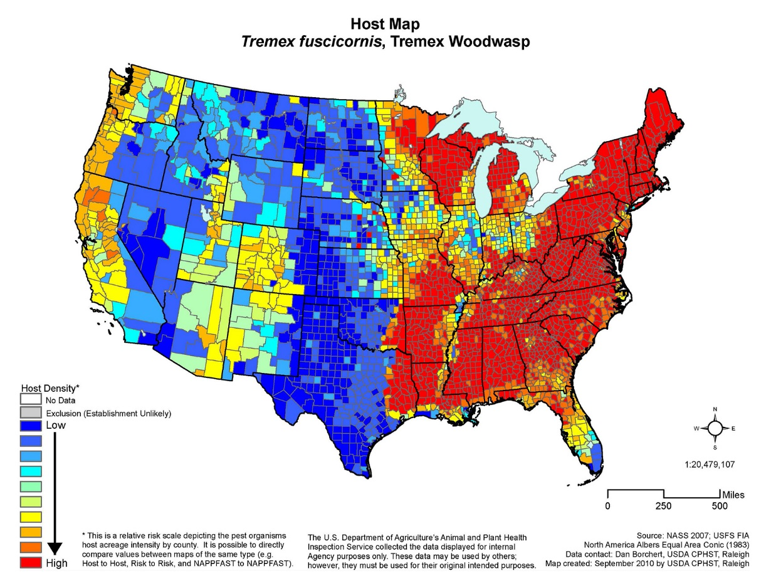
Host Availability
Medium/high
Maples
Poplars
Birch
Beech
Oak
Walnut
Willows
Elms
Apples
Pears
NAPPFAST Host Map source: CERIS Pest Tracker
Notes:
Tremex wood wasp is a generalist, attacking a wide variety of hardwood trees that are abundant and occur contiguously in the US.
In Chile, the tree most impacted by the Tremex wood wasp is poplar.

Slide 9
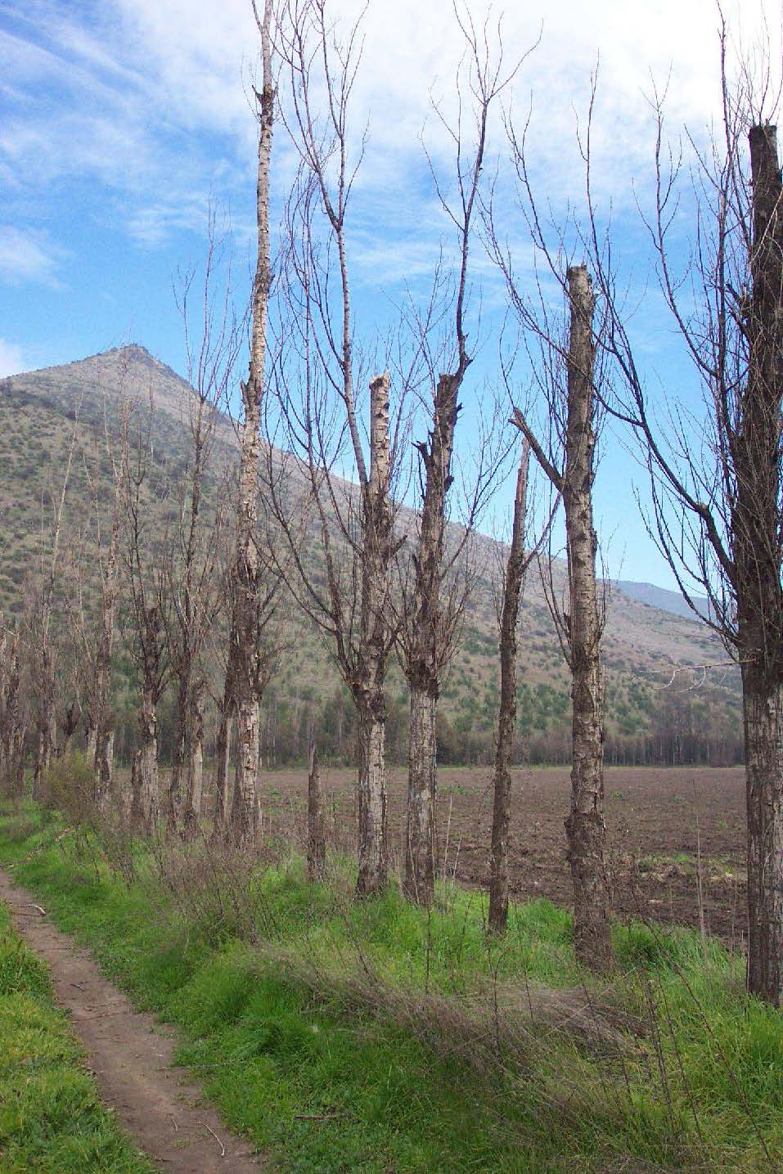
Potential
Environmental Impact
High
Reduce biodiversity
Disrupt ecosystem function
Degrade critical habitat
Loss of windbreaks
Four threatened or endangered species potential hosts
Photo: © Laura Maly, SENASA
Notes:
Forest damage, defoliation and mortality have significant impacts on both the environment and ecosystem health. When assessing environmental impact such things as effects on biodiversity and disruption of overall ecosystem function are considered. In forests already under stress by defoliators or drought, establishment of the Tremex wood wasp could cause extensive tree mortality which could alter the composition of many forests.
While Tremex wood wasp prefers weakened and stressed trees its native range, in places where it has been introduced it is also attacking healthy trees.

Slide 10
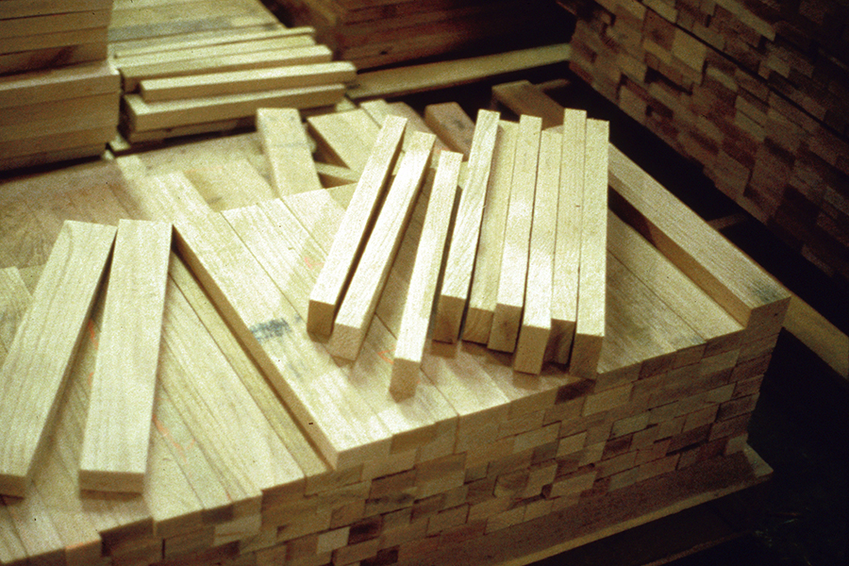
Potential
Economic Impact
High
Timber losses
Forest product industries at risk
Domestic and/or international quarantines may impact trade
Photo: © Stephen Bratkovich, USDA Forest Service, Bugwood.org
Notes:
The Tremex wood wasp, like many siricid wasps, use a fungus to aid in their ability to feed on and digest wood. Females introduce this fungus when she oviposits eggs, and the larvae feed on the fungus and decaying wood as it grows through the host tree. The galleries created by the wasp larvae and the decay caused by the fungus render the wood unusable.
Because of its wide host range, the Tremex wood wasp is a threat to natural areas, property values through shade tree loss, forest product industries and ecological processes. Any quarantines imposed on the US would cover a broad range of wood products due to the wasp’s generalist nature, causing widespread impacts to trade in wood products.

Slide 11
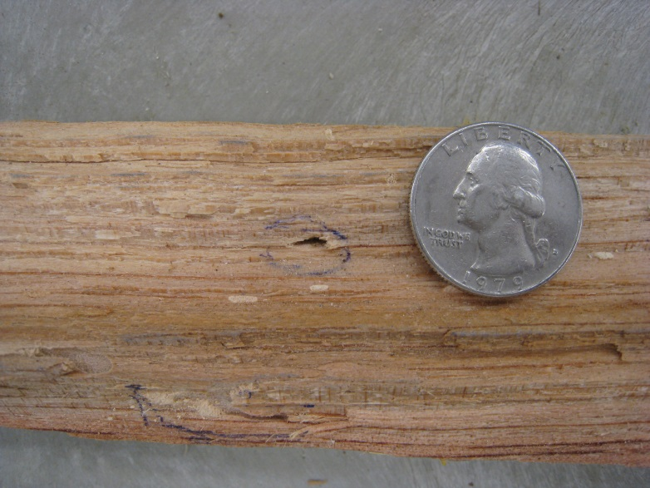
Entry Potential
Intercepted wood packaging material with borer damage.
High
Larvae may be difficult to detect during routine inspections at ports
Many ports have suitable climates & hosts
Already introduced to Chile & Argentina
Photos: © Peter Reagel, USDA APHIS PPQ CPHST
Notes:
Siricids are one of the known families of wood-boring pests intercepted in solid wood packaging material. Other invasive introductions (EAB and ALB) are believed to have been introduced through wood packing material in international trade.
It is believed that the introduction to Chile came from infested wooden crates from China.

Slide 12
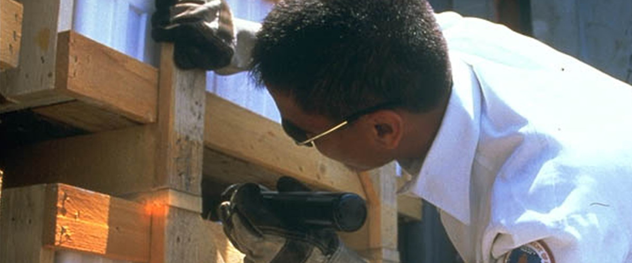
Introduction pathways
Eggs, larvae and pupae can be transported in wood products
  Larvae easily survive long periods inside wood
  Recently established in Chile—believed larvae and pupae emerged from wooden crates from China
  Already intercepted once at a port in Georgia
Photo: © USDA APHIS PPQ Archive, Bugwood.org
Notes:
Eggs, larvae and pupae can be transported as hitchhikers in wooden packing material and the pest has successfully established after introductions into Australia and Chile.
Due to the cryptic nature of the pest and the availability of host material around ports of entry, there will always be the chance that the Tremex wood wasp could be introduced. So having this pest on your radar is essential to finding it early before it can become widespread!

Slide 13
Spread potential—natural dispersal
Adult wasps are capable of dispersing more than several km per year.
Newly established populations may go undetected for many years due to cryptic nature, concealed activity, slow development of damage symptoms or misdiagnosis.
Notes:
On its own, adults are strong fliers and are capable of flying several kilometers in search of host material. Wind can aide dispersal by increasing that base range.
Given the wasp’s cryptic nature and its similarity to our native pigeon Tremex wasp, new infestations may go unnoticed until they are firmly established.

Slide 14
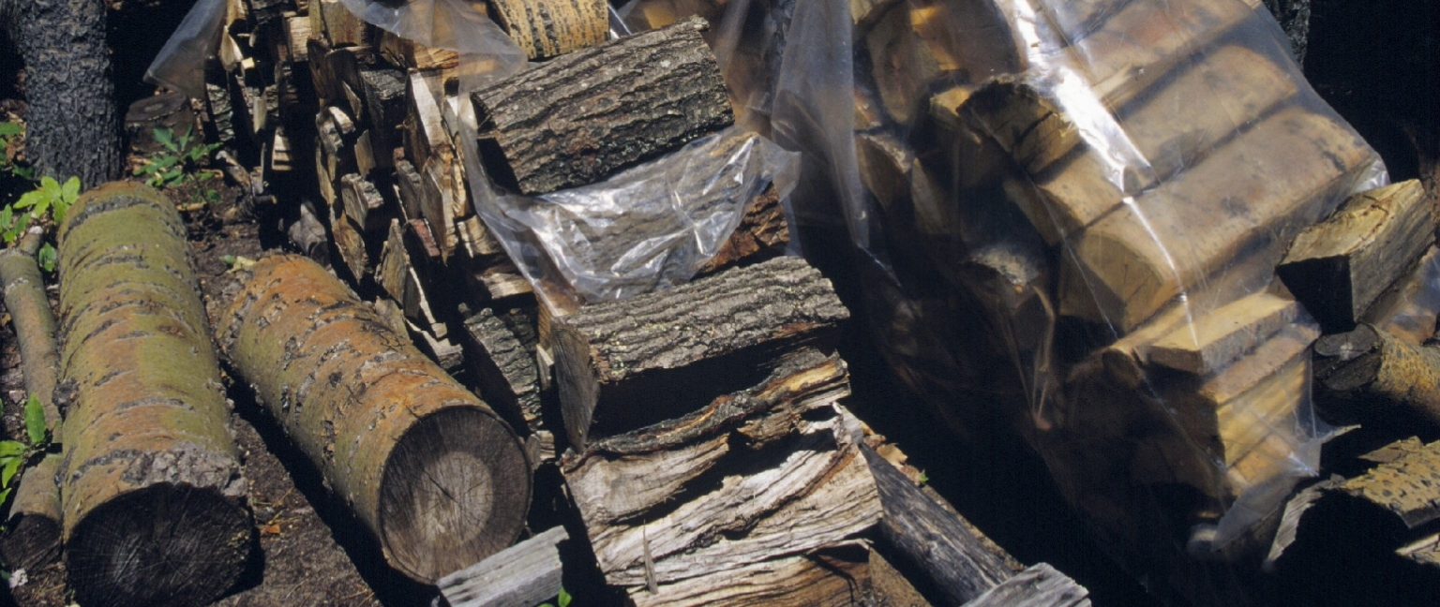
Spread potential—human assisted spread
Once introduced, larvae and pupae can be transported unknowingly to destinations anywhere in the US
Like other borers, firewood is a potential pathway for long distance movement to new areas
Photo: © Joseph O'Brien, USDA Forest Service, Bugwood.org
Notes:
If the Tremex wood wasp was to be introduced, it has the potential to move long distances or to new locations the same ways that the emerald ash borer could move around, unknowingly in infested wood like pallets or firewood. This photo shows oak being used as firewood.

Slide 15
Insect biology—Siricidae
Cryptic, live almost their whole lives inside of trees.
Some (i.e., Sirex and Tremex) have a symbiotic relationship with wood-decaying fungi.
Larvae mainly feed on wood, but rely on ingested fungal enzymes to break down cellulose (in some species, the fungus might also be directly used for nutrition).
Notes:
Siricid wasps are cryptic, living almost their whole lives inside of trees. Some Siricid wasps (i.e., Sirex and Tremex) have a symbiotic relationship with wood-decaying fungi.
Siricid larvae mainly feed on the wood, but rely on ingested fungal enzymes to break down cellulose (in some species, the fungus might also be directly used for nutrition).
Reference: Map of Life - "Agriculture in wood wasps"
http://www.mapoflife.org/topics/topic_472_Agriculture-in-wood-wasps/

Slide 16
Insect biology—Tremex fuscicornis
Female uses long ovipositor to insert eggs into cambium layer of hardwood trees
She inoculates egg-laying sites with a very specific wood-decaying fungus, Cerrena unicolor
Fungus decomposes surrounding wood; early instars eat the fungus, later instars eat the fungus and decaying wood.
Notes:
Tremex fuscicornis is not that well studied so little is known about their exact biology and habits. We do know that they have a symbiotic relationship with the fungus Cerrena unicolor; the wasp spreads the fungus to new host trees, and the larvae feed on the fungus and decomposing wood.

Slide 17
Life cycle
Eggs—inserted into cambium layer along with symbiotic fungus
Larvae—upon hatch, first feed on fungal hyphae and bore into wood to construct longitudinal, semicircular galleries. Larvae continue to feed on the fungus and digested wood as they grow.
Pupae—larvae pupate within galleries a few centimeters beneath the bark.
Notes:
Much of the life cycle of Tremex fuscicornis is unknown. Eggs are deposited into the cambium layer of the host tree by the adult female wasp, who punctures the tree with her long ovipositor and simultaneously inoculates the host with the fungus Cerrena unicolor. Upon hatching, larvae feed on fungal hyphae and construct longitudinal, semicircular galleries. Individual galleries can be up to a meter long and get wider as the larva grows.

Slide 18
Life cycle
Adults—chew their way out of the tree leaving a 5-6mm round exit hole. They do not feed and live for only a few weeks to mate and lay eggs.
In Chile, T. fuscicornis generally has a one year lifecycle.
Notes:
Adult wasps chew their way out of the tree. Exit holes are round and measure 5-6mm in diameter. After emergence, adults mate in the summer and fall; they do not feed, living for only a few weeks.
In Chile, T. fusicornis generally has a one year lifecycle with variations due to time of year, stage of development, and climate and temperature.

Slide 19
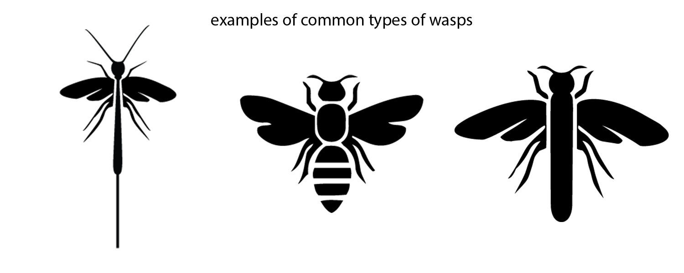
Identification—Siricid wasps
Order—Hymenoptera (ants, bees, wasps)
Suborder—Symphyta (sawflies, horntails, wood wasps)
Family—Siricidae
Large family characterized by broad waist and modified ovipositor
Notes:
Wood wasps belong to the insect order Hymenoptera (ants, wasps and bees) and are members of the suborder Symphyta—sawflies, horntails and wood wasps.
Siricidae is a large family characterized by a broad waist and an ovipositor modified to insert eggs into wood.

Slide 20
Identification—adults
Photo: © Stanislav Krejcik, meloidae
Notes:
Tremex fuscicornis looks very similar to our native siricid wasps, therefore, suspect individuals should be confirmed by a taxonomist with expertise in the family Siricidae.

Slide 21
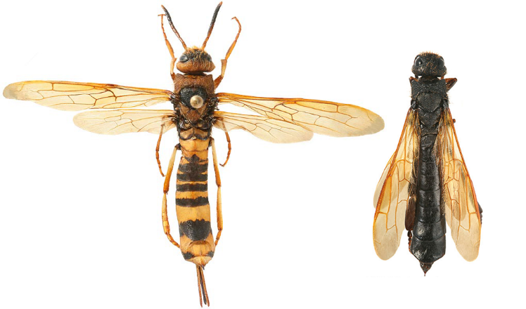
Identification—Adults
Broad waist
Threadlike (filiform) antennae
Spine or horn at end of abdomen
Variable size—typically over 20mm long with some females reaching over 45mm with ovipositor
Photo: Biological Survey of Canada
Notes:
Adults have two pairs of wings, a broad waist and long abdomen. Siricids have threadlike antennae and a spine at the tip of their abdomen which gives them the common name “horntail.” Both males and females have this feature.
Color is often used as a diagnostic feature to distinguish species of wood wasps but there is still a lot of variation between individuals.
Quality of food source plays a role in the size of individuals so is quite variable and not a useful diagnostic feature. Typically individuals are over 20 mm long, with some females measuring 45 mm with their ovipositor. Only female wasps have an ovipositor which is long and non-retractable and adapted for piercing wood. The ovipositor is protected by a sheath.
Tremex spp. are only found on hardwood trees.

Slide 22
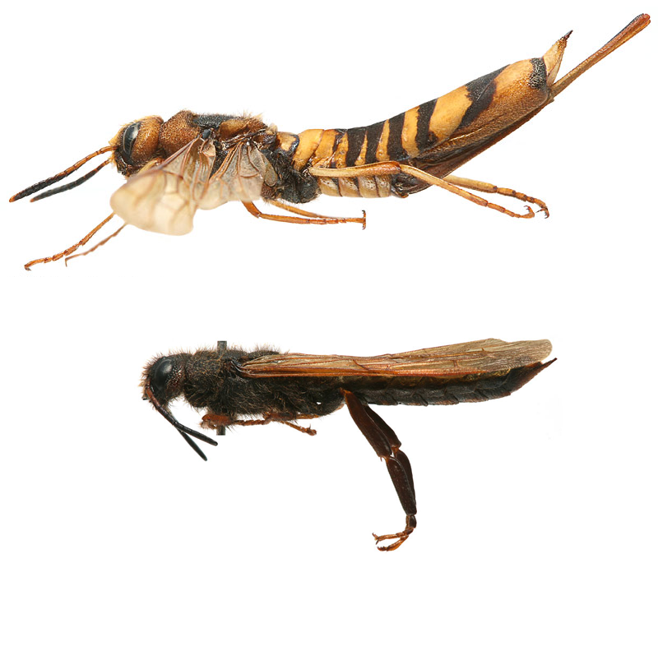
Identification—Adults
Females
Dark head and thorax
Abdomen orange-yellow with dark stripes
Lighter amber colored wings
Long ovipositor
Males
Completely black
Wings brown, darker than wings of female
Photo: Biological Survey of Canada
Notes:
Tremex females have a dark head and thorax with a banded abdomen of orange-yellow and black. They have amber colored wings that are lighter than the males.
Males are all black (head, thorax, abdomen, antennae and legs) with dark amber or brown wings.

Slide 23
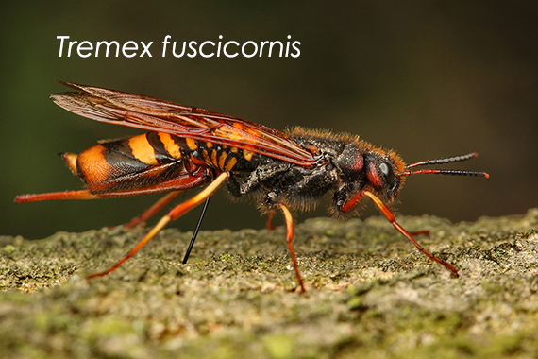
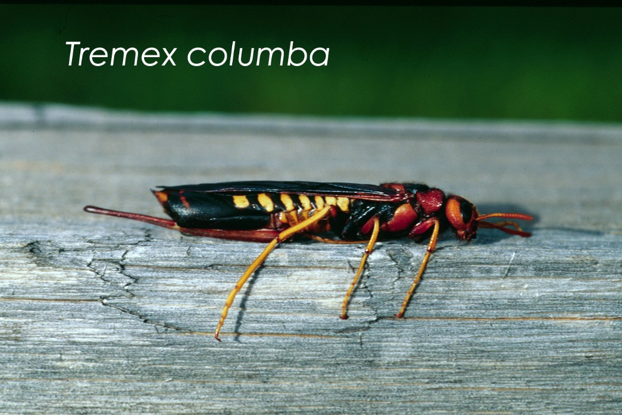
Tremex spp.
Antennae with 14–15 segments
Bodies without long yellow hairs
Similar species:
T. Columba, pigeon tremex
Differentiating between Tremex species is difficult and should be done by a taxonomist
Send to your NPDN diagnostic lab for confirmation!
Photos: (top) Stanislav Krejcik, meloidae; and (bottom) Steven Katovich, USDA Forest Service, Bugwood.org
Notes:
Tremex can be separated from other genera of siricids by the number of antennal segments they have: 14–15 segments. Additionally, they do not have long yellow hairs on their bodies.
The species most similar to Tremex fuscicornis is the native pigeon Tremex wood wasp. Here you see the pigeon Tremex below Tremex fuscicornis. They are remarkably similar, and pigeon Tremex are fairly common in North America.

Slide 24
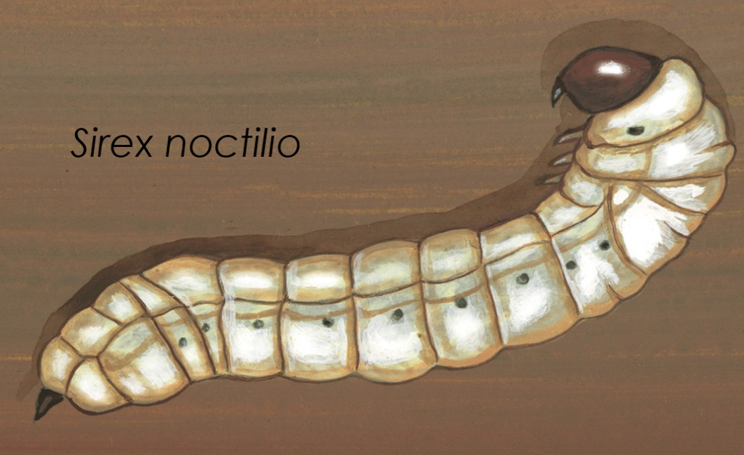
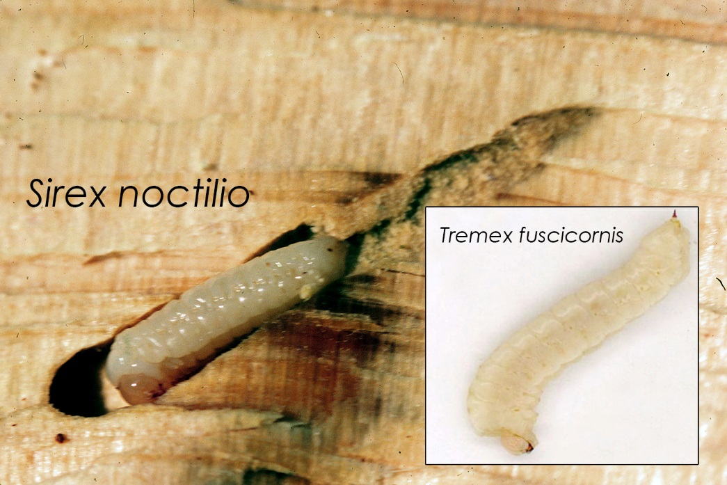
Identification—Larvae
Small spine at posterior of abdomen
Off-white, soft, cylindrical
3–4 cm in length
Distinct mandibles
Three pairs of rudimentary legs
Photos: (top) Robert Dzwonkowski, Bugwood.org; and (bottom) Dennis Haugen, Bugwood.org, inset INFOR-SAG.
Notes:
You are not likely to come across siricid eggs because they are inserted into the cambium of host trees. However, they are white, cylindrical and 1–2mm.
Larvae are creamy white and soft-bodied, with distinct mandibles and a spine at the posterior end of abdomen.

Slide 25
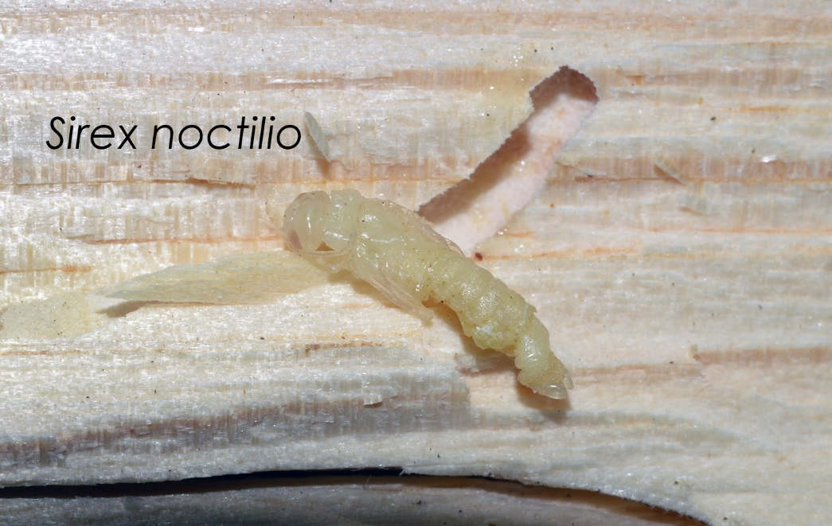
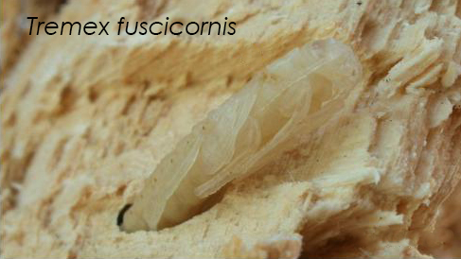
Identification—Pupae
3 cm in length
Creamy off-white, darkening prior to adult development
Distinct antennae and fully developed legs
Photos: (top) W. Ciesla, Forest Health Management International, Bugwood.org; and (bottom) N. Acosta, courtesy of Chilean Forest Sanitation Program
Notes:
Pupae have distinct antennae and fully developed legs. Creamy white initially darkening as they complete pupation.

Slide 26
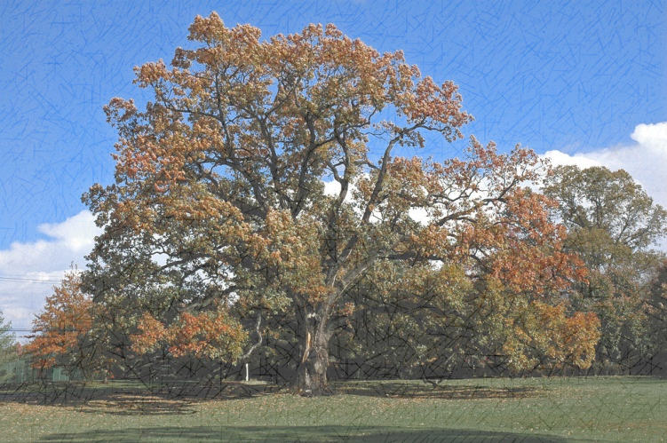
Hosts—T. fuscicornis attacks various hardwood trees
Primary: Populus spp., Salix spp.
Secondary: Acer negundo, Acer platanoides, Acer saccharum, Alnus spp., Betula spp., Fagus spp., Quercus spp., Juglans regia, Ulmus spp., Zelkova spp., Malus spp., Pyrus spp.,
Photo: © Leif Knutsen, wikimedia commons
Notes:
Host tree is important when identifying siricid wasps. Sirex spp. feed exclusively in conifers (softwood) while Tremex spp. feed exclusively in hardwood trees.
The primary hosts of Tremex fuscicornis are poplars and willows. In Chile, the species that is being most damaged by T. fuscicornis is the poplar used in urban areas and windbreaks on agricultural land. The Tremex wood wasp is a generalist, though, and can feed on many secondary species including many of our natives as well as agronomically important species such as apple, pear and maple.

Slide 27
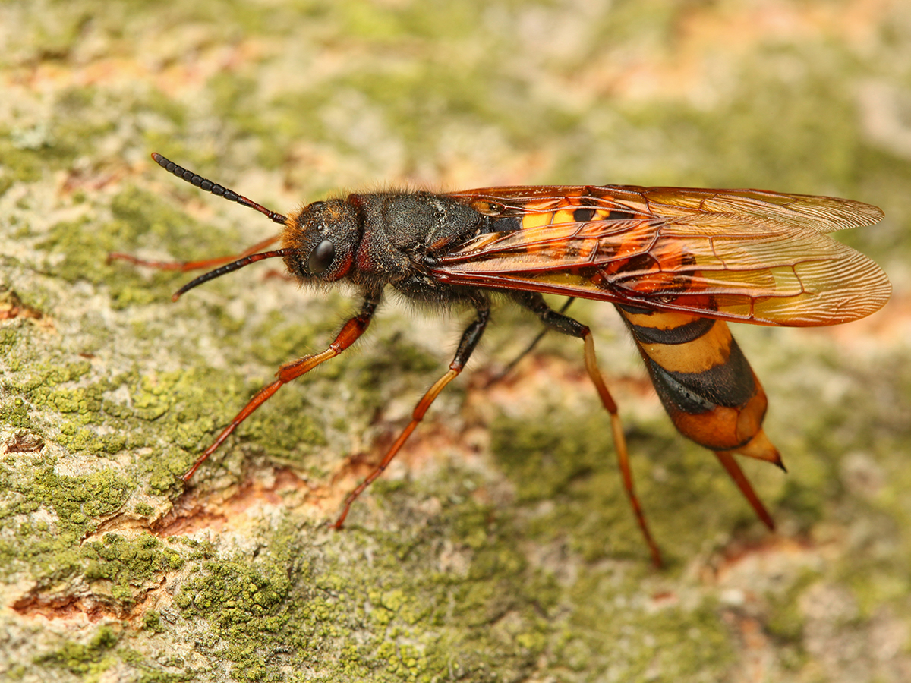
Signs and symptoms
Photo: © Stanislav Krejcik, meloidae.com
Notes:
Other pests and diseases as well as abiotic disorders such as drought can cause similar symptoms to those caused by Tremex wood wasp. Additionally, signs caused by the native Tremex columba, will also look the same.
Life stages of the insect itself or direct evidence of them such as exit holes or galleries are known as “signs”. Symptoms are the host plant’s response to the presence of the insect, such as leaf drop or lesions.

Slide 28
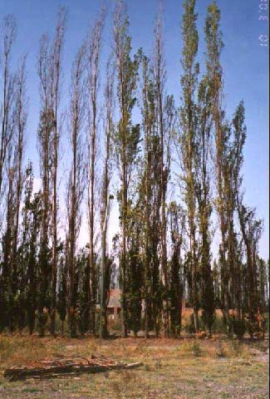
Symptoms
Thin / yellowing foliage
Branch and crown dieback
Reduced growth
Leaf and trunk necrosis
Loosened bark
Structural weakening
Dead and dying trees
Photo: © Laura Maly, SENASA
Notes:
Symptoms of Tremex wood wasp include thinning or yellowing foliage, branch and crown dieback, and reduced tree growth. Trees under attack may also show bark cracking, loosened bark and breakage resulting in structural weakening.

Slide 29
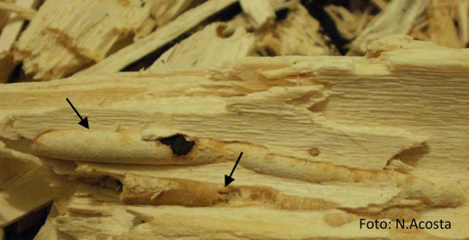
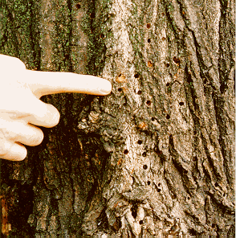
Signs
Photos: © N. Acosta (top) and Laura Maly, SENASA
Larval galleries packed with sawdust/frass
Small, round exit holes 5-6mm in diameter
Wasps flying near tree crown
Detached ovipositors
Notes:
Signs of Tremex wood wasp include larval galleries that are tightly packed with sawdust-like frass, round exit holes that are fairly shallow (the pupae mature a few centimeters below the bark surface), wasps flying near the crown of the tree during the summer and fall, and detached ovipositors in the bark.
As these would be difficult to differentiate from our native Tremex, expert ID will be necessary to identify this species.
The wood may be discolored by the symbiont fungus.

Slide 30
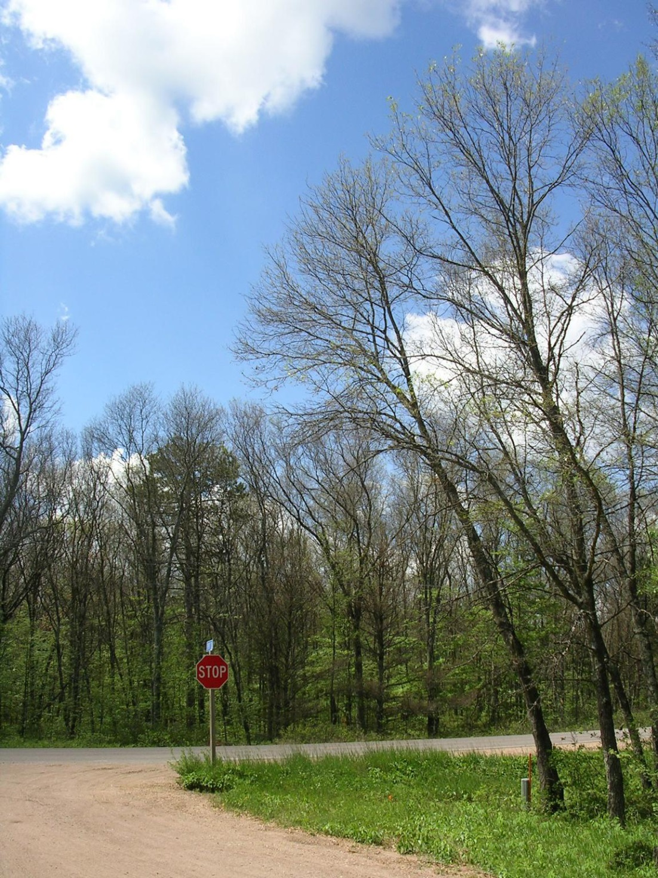
Scouting
Trees defoliated by gypsy moth.
Prefer
  Stressed trees
    Drought stressed
    Urban conditions including compacted soils or poor drainage
    Diseased or defoliated trees
  Poplars, willows and maples, oaks, beech, apple, etc
Photo: © Bill McNee, Wisconsin Dept of Natural Resources, Bugwood.org
Notes:
It is ideal to be on the lookout for unusual plant symptoms year round but you can use the following tips as a guide for when to look more closely for the symptoms and signs described here.
Within its native range, this pest prefers stressed or dead/dying hardwood trees—however it has been behaving differently in introduced regions, attacking healthy trees in addition to stressed ones.
Survey trees that are stressed by injury or disease, adverse weather conditions, planted in poor or compacted soils or have been defoliated by another pest such as gypsy moth.

Slide 31
Scouting
Look for host trees that show these symptoms
Chlorotic or discolored foliage
Stunted or reduced growth
Necrotic spots on trunks
Photo: © Joseph O'Brien, USDA Forest Service, Bugwood.org
Notes:
Examine canopies of host trees for symptoms of chlorosis or yellowing foliage and reduced or stunted growth. Examine trunks for necrotic spots.

Slide 32
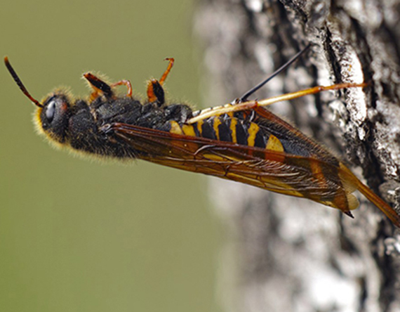
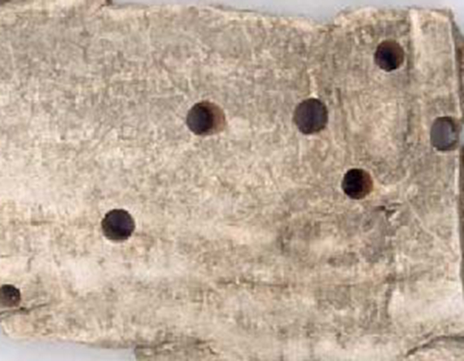
Scouting
Look for host trees that show these signs
Presence of adult wasps on trunk or flying near the crown
Detached ovipositors in trunks
Exit holes on trunks, shallow, 5-6mm round
Presence of parasitic wasps
Photo: (top) unknown photographer and (bottom) © Laura Maly, SENASA
Notes:
Symptomatic trees and host trees should be examined for signs of T. fuscicornis. Presence of adult wasps on trunk or flying near the crown. Detached ovipositors in trunks.
Additionally, if the insect has completed its life cycle, exit holes will be present on the trunks.

Slide 33
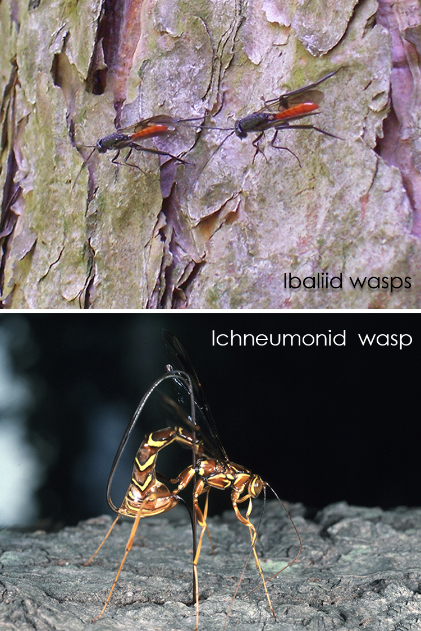
Scouting
Photos: top © Ethan Angell, NYSDAM and © Jim Occi, BugPics, Bugwood.org
Look for host trees that show these signs
Presence of adult wasps on trunk or flying near the crown
Detached ovipositors in trunks
Exit holes on trunks, shallow, 5-6mm round
Presence of parasitic wasps
Photo: © Joseph O'Brien, USDA Forest Service, Bugwood.org
Notes:
Ichneumonid and Ibaliid wasps are natural parisitoids of horntails and their presence could indicate that horntails are present.

Slide 34
What you should do…
If you see signs and symptoms described in this presentation on hardwood trees, look more closely for signs of the insect.
Tremex fuscicornis is a high-consequence insect pest of quarantine significance. It is not currently known to be established in the United States.*
Symptoms of T. fuscicornis are similar to those caused by other less serious pests.

Slide 35
Contact your state NPDN lab…
If you think you have found Tremex fuscicornis, contact the NPDN diagnostician in your state immediately.
Tell him/her you have a pest which you suspect could be T. fuscicornis and would like to send in a sample for preliminary screening.
Explain that this is a significant pest we are surveying for through the Sentinel Plant Network.

Slide 36
Contact your state NPDN lab…
Take a series of quality photographs of symptoms, and diagnostic features outlined in this presentation and send them to the diagnostician.
Record host information and symptoms observed.
The NPDN diagnostician may perform preliminary identification however confirmation must be done by the national identifier (NIS) for this pest; your NPDN diagnostician will send suspect samples to the national identifier.
If the diagnostician asks you to send a physical sample…

Slide 37
Send in a proper sample…
Remember when sending samples that are considered to be significant or high-consequence these tips…
  Capture multiple, whole specimens if possible
  Kill insects by placing them in the freezer for at least 24 hours.
  Loosely wrap insects in tissue and place in a small crush proof container or sturdy lockable bag
  Place container or bag in another lockable bag
  Place these in a sturdy shipping container
  Include ALL of the proper sample submission forms required by your NPDN lab
Review NPDN’s sample submission module and contact your state diagnostician with any questions.
Notes:
Remember when sending samples that are considered to be significant or high-consequence these tips…
Capture multiple, whole specimens if possible.
Kill insects by placing them in the freezer for at least 24 hours.
Loosely wrap insects in tissue and place in a small crush proof container or sturdy lockable bag
Place container or bag in another lockable bag
Place these in a sturdy shipping container
Include ALL of the proper sample submission forms required by your NPDN lab
Review NPDN’s sample submission module and contact your state diagnostician if you have sample collecting or packaging questions.

Slide 38
References
Allard, Gillian. 2008. Forest Health and Biosecurity Papers: Overview of Forest Pests – Chile. Published by United Nations FAO: Forestry Department.
Bates, Chip, Mark McClure, Lynne Womack, Chris Barnes. 2014. Georgia’s Forest Health Highlights Report: October 1, 2013 through September 30, 2014. Published by Georgia Forestry Commission. Accessed August 20, 2015 at http://www.fs.fed.us/foresthealth/fhm/fhh/fhh_14/GA_FHH_2014.pdf
Ciesla, W. M. 2003. Tremex fuscicornis. Pest Reports, North American Exotic Forest Pest Database (EXFOR). Accessed August 20, 2015. https://caps.ceris.purdue.edu/webfm_send/316
Diodato, Liliana. 2003. Insectos barrenadores de madera de la corteza. Programa de Sanidad Forestal: area enomologica. Chapter 6 in Manejo integrado de la avispa taladradora de la madera Tremex fuscicornis Fabr., con énfasis en control biológico. Informe final.
Hardin, Jesse A. 2013. Tremex fuscicornis(Fabricius) New Pest Response Guidelines. Presented at APS NPDRS Workshop, April 16, 2013, Tysons Corner, VA; accessed online Aug 20, 2015 at http://www.apsnet.org/meetings/topicalmeetings/NPDRS/Documents/2013/J.%20Hardin.pdf.
ProtectUs. Exotic Pests of Concern for Ornamental Plants. Accessed August 19, 2015 at http://entnemdept.ifas.ufl.edu/hodges/ProtectUs/presentations/Exotic_Pests_Ornamental_Plants.pdf.

Slide 39
References
Schiff, N. M., S. A. Valley, J. R. LaBonte, and D. R. Smith. 2006. Guide to the Siricid Woodwasps of North America. Forest Health Technology Enterprise Team. United States Department of Agriculture, Forest Service, Morgantown, West Virginia. 102 pp. http://www.fs.fed.us/foresthealth/technology/pdfs/GuideSiricidWoodwasps.pdf
USDA APHIS PPQ. 2012. New Pest Response Guidelines: Tremex Wood Wasp (Tremex fuscicornis). Accessed on August 20, 2015 at https://www.aphis.usda.gov/import_export/plants/manuals/emergency/downloads/nprg-TremexWoodWasp.pdf.
USDA Risk Assessment Maps. Accessed August 18, 2015 at http://www.nappfast.org/caps_pests/CAPS_Top_50.htm.
Notes:
http://cjai.biologicalsurvey.ca/sgsbws_21/Siricidae/Species/Tremex/fuscicornis.html

Slide 40
Questions
on this module or the NPDN contact Rachel McCarthy at rachel.mccarthy@cornell.edu
on how to collect or submit a sample contact your state NPDN diagnostician at www.npdn.org

Slide 41
Presentation credits
Authored by
Rachel McCarthy, NPDN-SPN Manager, Plant Pathology and Plant-Microbe Biology, Cornell University
Caroline Marschner, Invasive Species Extension Associate, School of Integrated Plant Science at Cornell University

Slide 42
Presentation credits
Reviewed by
William M. Ceisla, Forest Health Management International, Fort Collins, Colorado

Slide 43
Publication details
This publication can be used for non-profit, educational use only purposes. Photographers retain copyright to photographs or other images contained in this publication as cited. Authors and the website should be properly cited. Images or photographs should also be properly cited and credited to the original source.
Published—September 2015

Slide 44

The Sentinel Plant Network
The Sentinel Plant Network (SPN) is a collaboration between the American Public Gardens Association (APGA) and the National Plant Diagnostic Network (NPDN) and is funded through the USDA’s Animal and Plant Health Inspection Service (APHIS).
Notes:
We believe that the never ending battle to slow or stop exotic pest and pathogen introductions can best be waged by the combined efforts of two organizations with similar goals.
The partnership, dubbed the Sentinel Plant Network is a cooperative project between the American Public Gardens Association (APGA) and the National Plant Diagnostic Network (NPDN) with funds for cementing the union coming from USDA-APHIS.
The Sentinel Plant Network is expected to enhance diagnostic capabilities via improved communication between public gardens and expert diagnostic facilities with access to advanced technologies.

Slide 45
The Sentinel Plant Network’s Mission
The Sentinel Plant Network contributes to plant conservation by engaging public garden professionals, volunteers and visitors in the detection and diagnosis of high-consequence pests and pathogens.
For more information on the Sentinel Plant Network visit www.sentinelplantnetwork.org

